Slide 1

Web-application for,
Village Vyapar
“Buy, Sell and Find just about Village Product (c2c)”

Slide 2
INDEX
No. | Content | Slide No.
1 | Group Information | 3
 | Company Profile | 4
3 | Project Definition | 5
4 | System Development Platform | 6
5 | Admin Panel | 7
6 | Customer Panel | 72
7 | Reports | 114
8 | References | 129

Slide 3
1 | Group Information | 3
 | Company Profile | 4
3 | Project Definition | 5
4 | System Development Platform | 6
5 | Admin Panel | 7
6 | Customer Panel | 72
7 | Reports | 114
8 | References | 129

Slide 4
Group Information :
GROUP NO : 04
Full Name | Enrollment No
Raja Himani Yatin | 205160694004
Chauhan Zeel Jitendrakumar | 205160694009
Parmar Devansh Rajeshbhai | 205160694023
Lashkari Parth Ashokbhai | 205160694029
Internal Faculty : :
Prof. Alka Patel

Slide 5
1
INTRODUCTION

Slide 6

Existing System :
Existing system is trading between people through calls,
and middle man therefore it is limited geographically.

Slide 7


Need for the New System :
The geographical limitation stops the business from growing and hence a lot of products do not get much attention.
It is difficult to account for the sales.
Cost of product is increased as middle man is included also
there is thin profit margin

Slide 8
Objective of New System :
This system allows to directly communicate via chat board so customer and
seller can negotiate on suitable price.
To increase the sales of the current small scale village businesses.
To provide multiple source of the same products which ensures that the
customer gets the desired quality product.
Cost of product is reduced as middle man is eliminated.
Customer can view products in any native language.

Slide 9

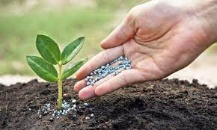
Project Definition :
This project is aimed at developing a web application that depicts online shopping of village products such as
food, Animals feed, Handicraft etc.
This web application also allows customer to
sell the product and others can purchase or vice versa
(i.e. Customer to Customer).
It provides a communication medium via chat board.

Slide 10




Core Components :
Admin
Customer
Visitor

Slide 11
Admin
Login
Manage Profile
Manage Customers
Manage Category & Sub category
Manage Products
Manage Inquiry
Manage Feedback
Generate Reports

Slide 12
Customer
Login
Manage Profile
Search Rural Product
View Categories & Sub Categories
View Rural Product in multiple language
Chat with Seller/Buyer
Inquiry
Feedback
Manage Inquiry
Manage Product
Manage Wishlist

Slide 13
Visitor
Registration
Search Rural Product
View Rural Product
View Feedback & Rating

Slide 14
Project Profile :

Slide 15
Assumptions & Constraint :

Slide 16
Advantages of Proposed System :

Slide 17
Disadvantage of Proposed System :

Slide 18
2
Requirement Determination & Analysis

Slide 19
3
Data Dictionary

Slide 20
1. Admin
DISCRIPTION :
Details of Admin Data table.
Here a_id is primary key.
Admin
Column Name | Type | Constraint
a_id | int(10) | Primary key(AI)
a_name | varchar(100) | Notnull
a_email | varchar(100) | Notnull
a_password | varchar(100) | Notnull
a_phone | bigint(12) | Notnull
a_img | varchar(100) | Default(default.jpg)

Slide 21
2. Categories
Categories
Column Name | Type | Constraint
cat_id | int(10) | Primary key(AI)
cat_name | varchar(100) | Notnull
cat_img | Text | Notnull
DISCRIPTION :
Details of Category table.
Here cat_id is primary key.

Slide 22
3. Chats
Categories
Column Name | Type | Constraint
m_id | Int(10) | Primary Key(AI)
to_user | Int(10) | Foreign Key (Customer->c_id)
from_user | Int(10) | Foreign Key (Customer->c_id)
message | Text | Notnull
timestamp | Timstamp | Notnull
status | Int(1) | notnull
DISCRIPTION :
Details of Category table.
Here cat_id is primary key.
Here to_user is foreign key.
Here from_user is foreign key.

Slide 23
4. Customer-1
Customer
Column Name | Type | Constraint
c_id | Int(10) | Primary Key(AI)
c_name | Varchar(50) | notnull
email | Varchar(100) | notnull
password | Text | Notnull
Phone no | bigint | Notnull
DISCRIPTION :
Details of Customer table.
Here cat_id is primary key.
Here to_user is foreign key.
Here from_user is foreign key.

Slide 24
4. Customer-2
Customer
Column Name | Type | Constraint
c_img | varchar(100) | notnull
address | Varchar(100) | notnull
village | Varchar(50) | notnull
district | Varchar(50) | Notnull
pincode | Int(6) | notnull
DISCRIPTION :
Details of Customer table.
Here cat_id is primary key.
Here to_user is foreign key.
Here from_user is foreign key.

Slide 25
5. Feedback
Feedback
Column Name | Type | Constraint
C_id | Int(10) | Primary Key(AI)
P_id | Int(10) | Foreign Key (product->p_id)
Desc | text | notnull
f_date | date | Notnull
DISCRIPTION :
Details of Feedback table.
Here c_id is primary key.
Here p_id is foreign key.

Slide 26
6. Inquiry
Inquiry
Column Name | Type | Constraint
i_id | Int(10) | Primary Key(AI)
c_name | varchar(50) | notnull
Email | Varchar(50) | Notnull
Subject | Varchar(50) | Notnull
Comp_name | Varchar(50) | Notnull
Message | Text | Notnull
Reply | Text | Notnull
Checked | Int(11) | notnull
DISCRIPTION :
Details of Inquiry table.
Here cat_id is primary key.

Slide 27
7. Plans
DISCRIPTION :
Details of Plans table.
Here p_id is primary key.
Plans
Column Name | Type | Constraint
P_id | Int(11) | Primary Key(AI)
Plan | Text | notnull
Price | Int(11) | Notnull
Days | Int(11) | Notnull

Slide 28
8. Product-1
Product
Column Name | Type | Constraint
p_id | Int(10) | Primary Key(AI)
p_name | varchar(100) | notnull
p_price | Int(8) | Notnull
p_desc | Text | Notnull
p_date | Date | Notnull
qoh | Int(10) | Notnull
img | Varchar(100) | Notnull
DISCRIPTION :
Details of Product table.
Here p_id is primary key.
Here cat_id is foreign key.
Here subcat_id is foreign key.
Here c_id is foreign key.

Slide 29
8. Product-2
Product
Column Name | Type | Constraint
Cat_id | Int(10) | Foreign key (AI) Category->c_id
Subcat_id | Int(10) | Foreign key(AI) Subcategory-> subcat_id
C_id | Int(10_ | Foreign Key(AI) Customer->c_id
Total_like | Int(1) | Notnull
Total_view | Int(10) | Notnull
DISCRIPTION :
Details of Product table.
Here p_id is primary key.
Here cat_id is foreign key.
Here subcat_id is foreign key.
Here c_id is foreign key.

Slide 30
9. Sub-category
DISCRIPTION :
Details of subcategory table.
Here subcat_id is primary key.
Here cat_id is foreign key.
Subcategory
Column Name | Type | Constraint
Subcat_id | Int(10) | Primary Key(AI)
Subcat_name | varchar(100) | notnull
Cat_id | Int(8) | Foreign key(AI) Category->cat_id

Slide 31
10. wish-list
DISCRIPTION :
Details of wishlist table.
Here c_id is foreign key.
Here p_id is foreign key.
Wish-list
Column Name | Type | Constraint
c_id | Int(10) | Foreign key (AI) Customer->c_id
p_id | Int(10) | Foreign key(AI) product->p_id

Slide 32
4
Screen-shots (Customer)

Slide 33

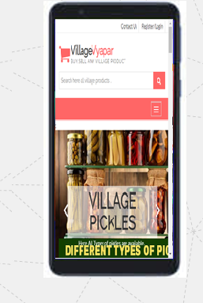
Requirement Determination

Slide 34
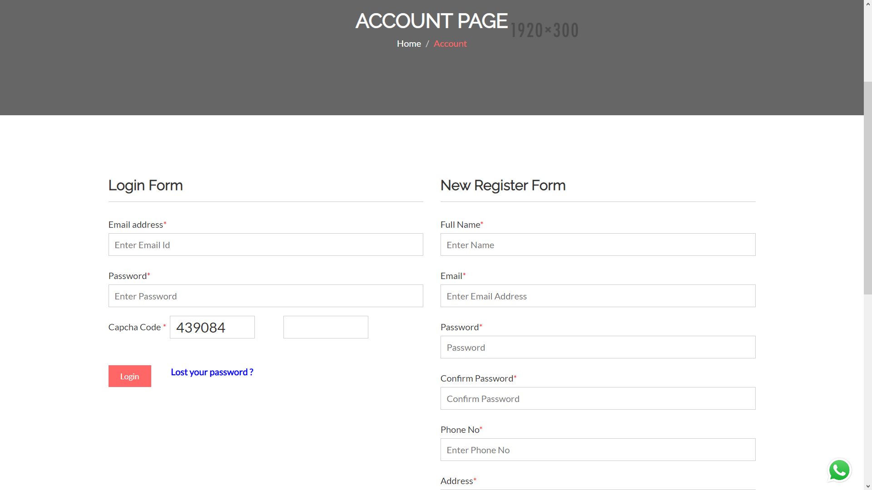
Login and Registration page

Slide 35
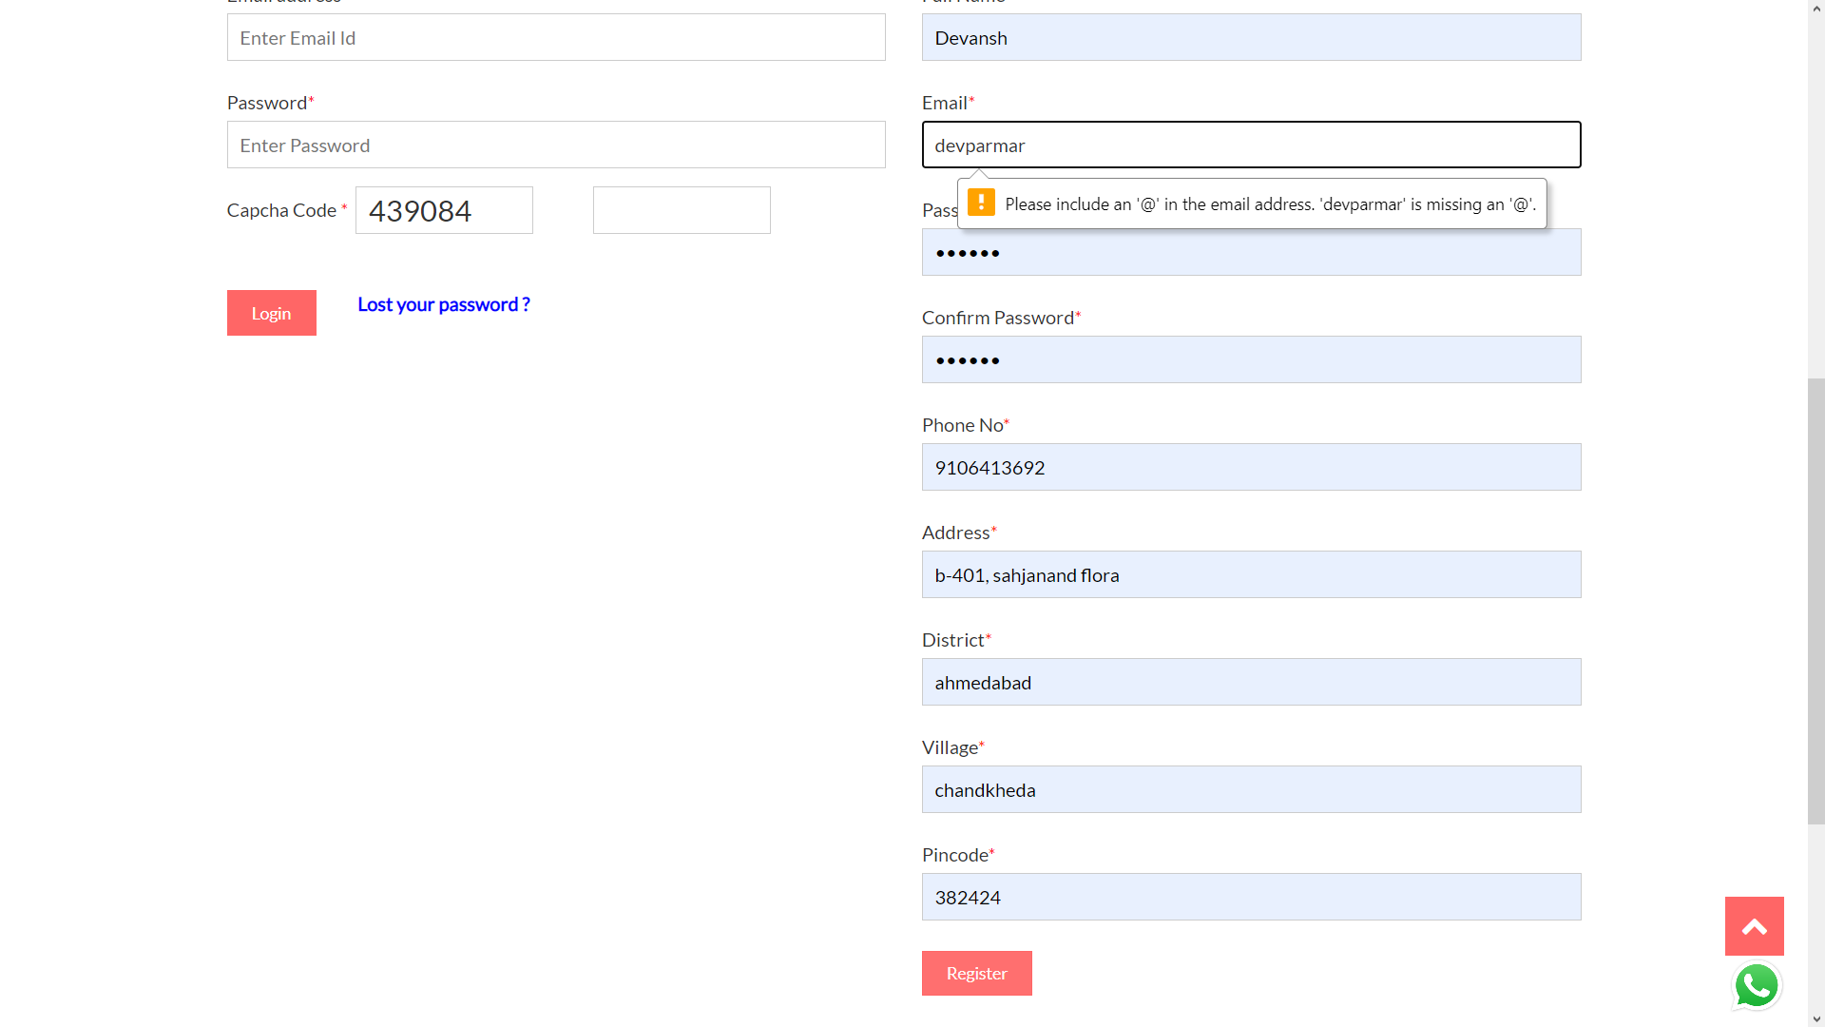
Registration with invalid credentials

Slide 36
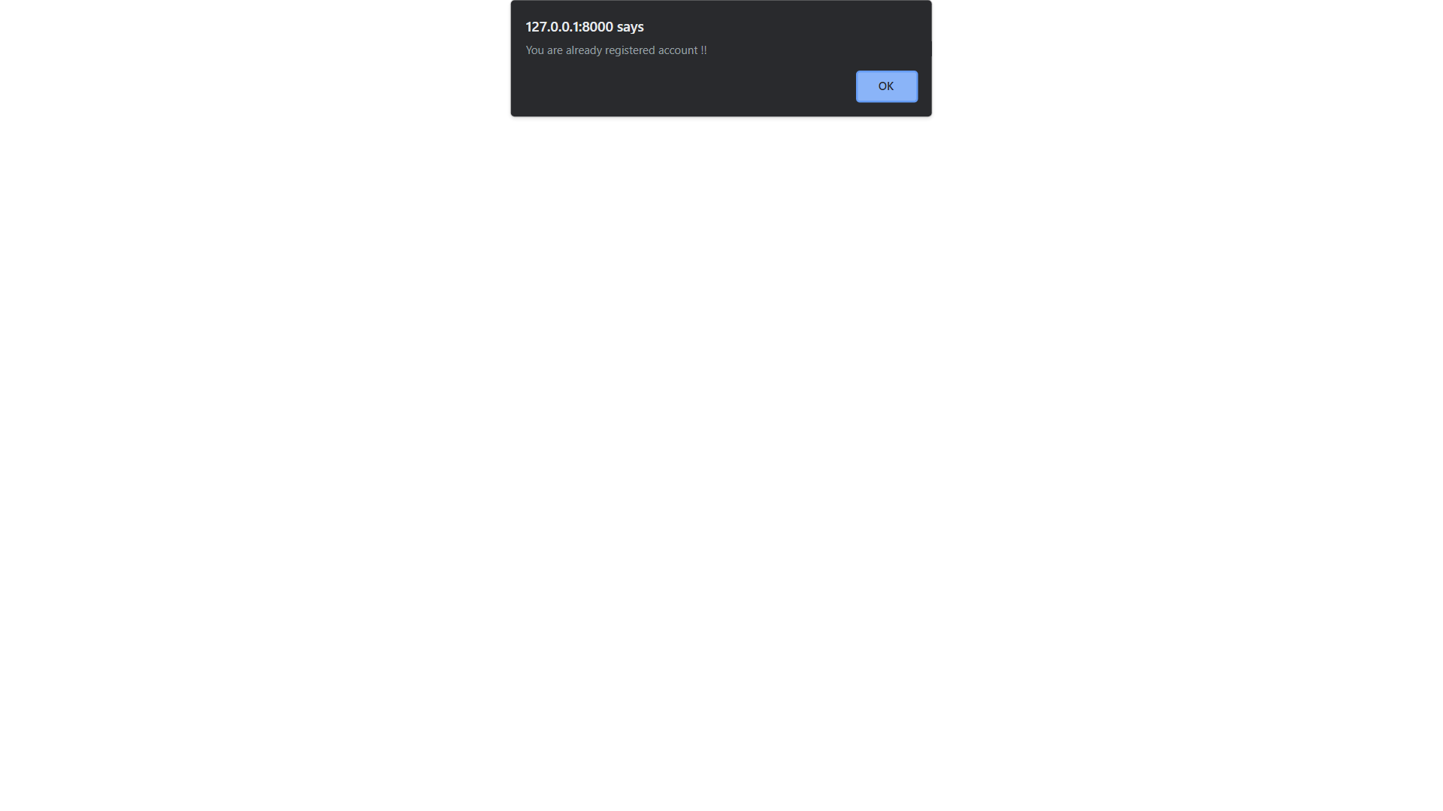
Registration with existing email

Slide 37

OTP sent at email on New Registration

Slide 38
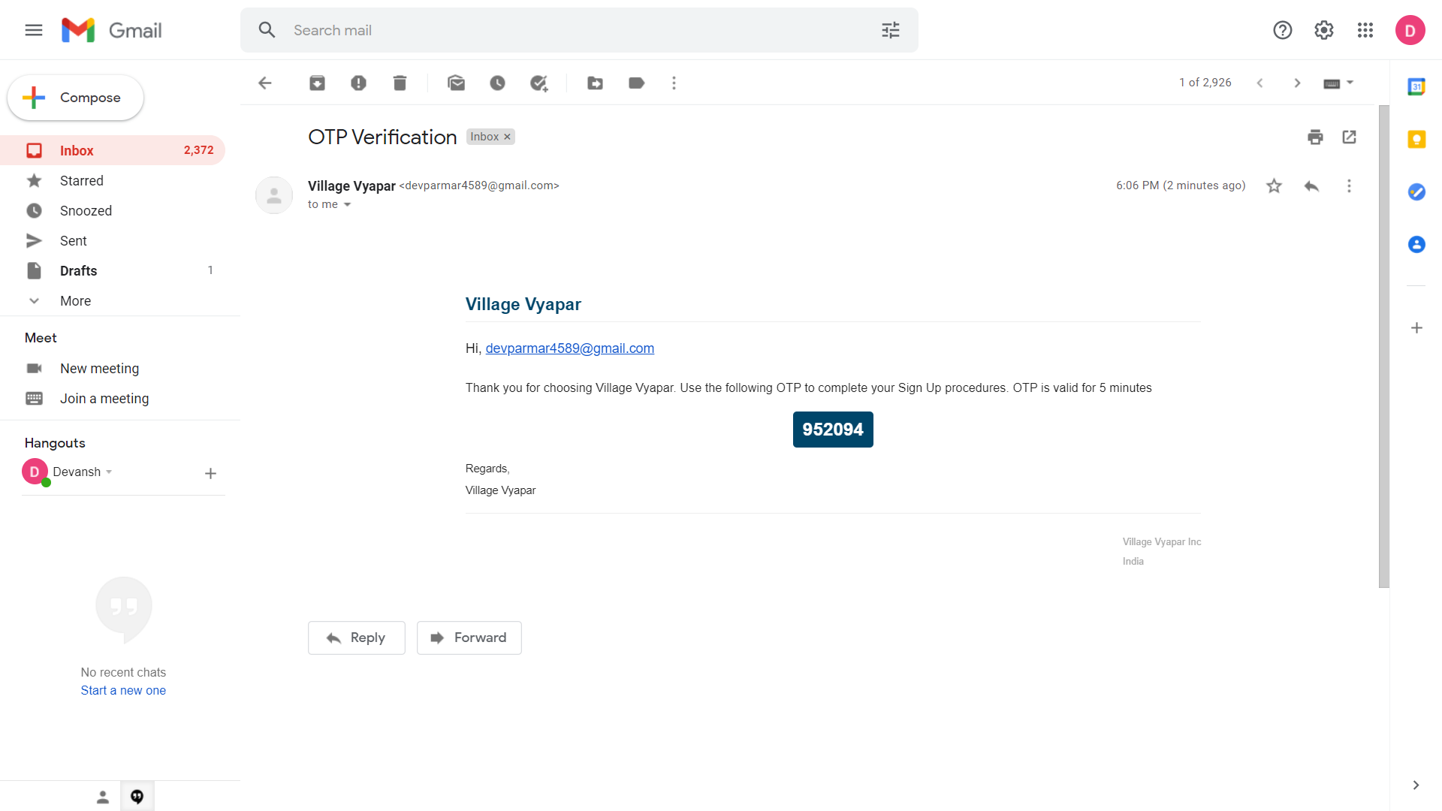
OTP sent at email on New Registration

Slide 39
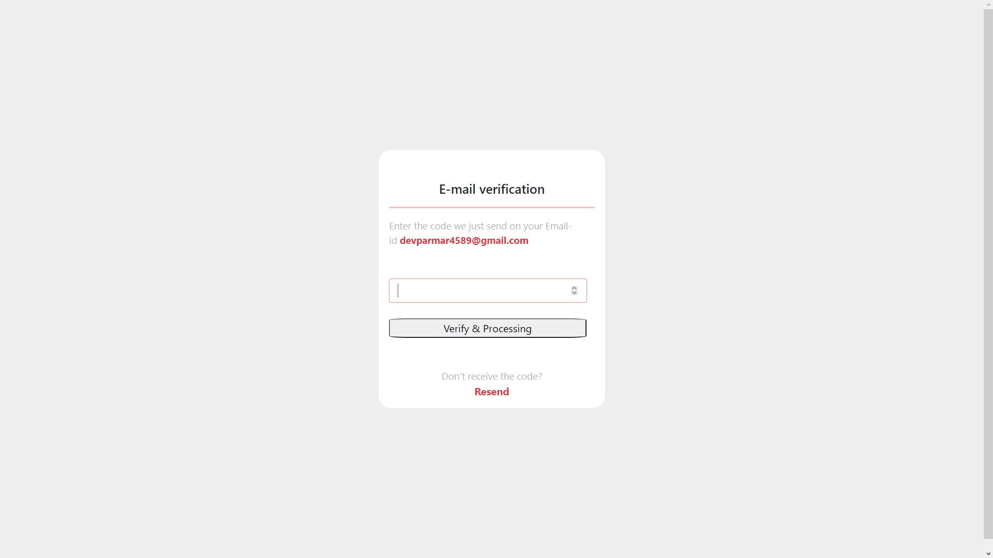
Confirm OTP sent at email

Slide 40

Homepage after Registration and login

Slide 41

Login with invalid credentials

Slide 42
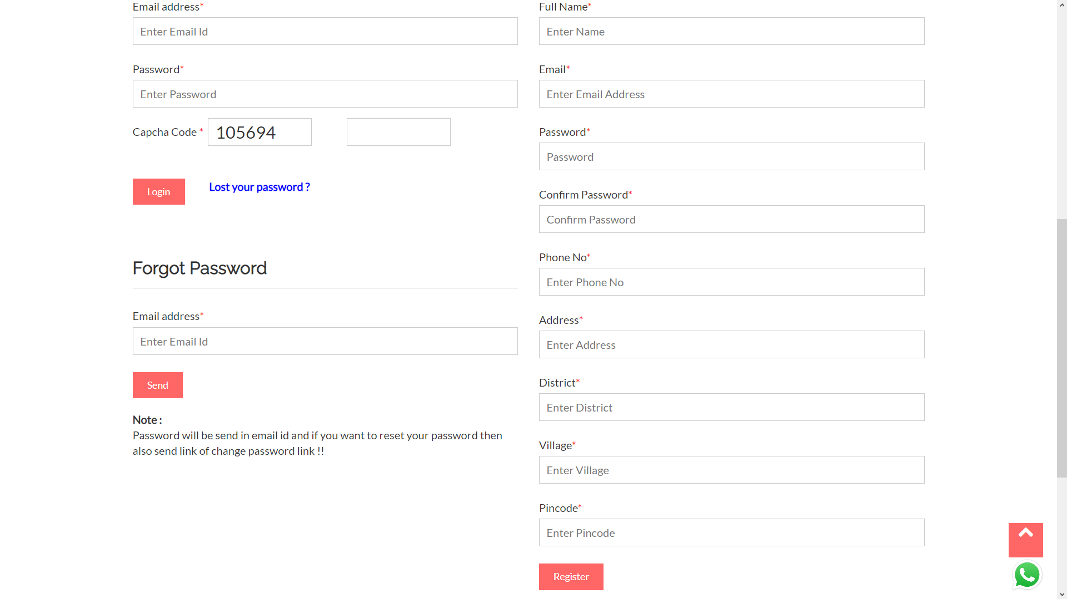
Forgot password

Slide 43

Lost password sent at email address

Slide 44
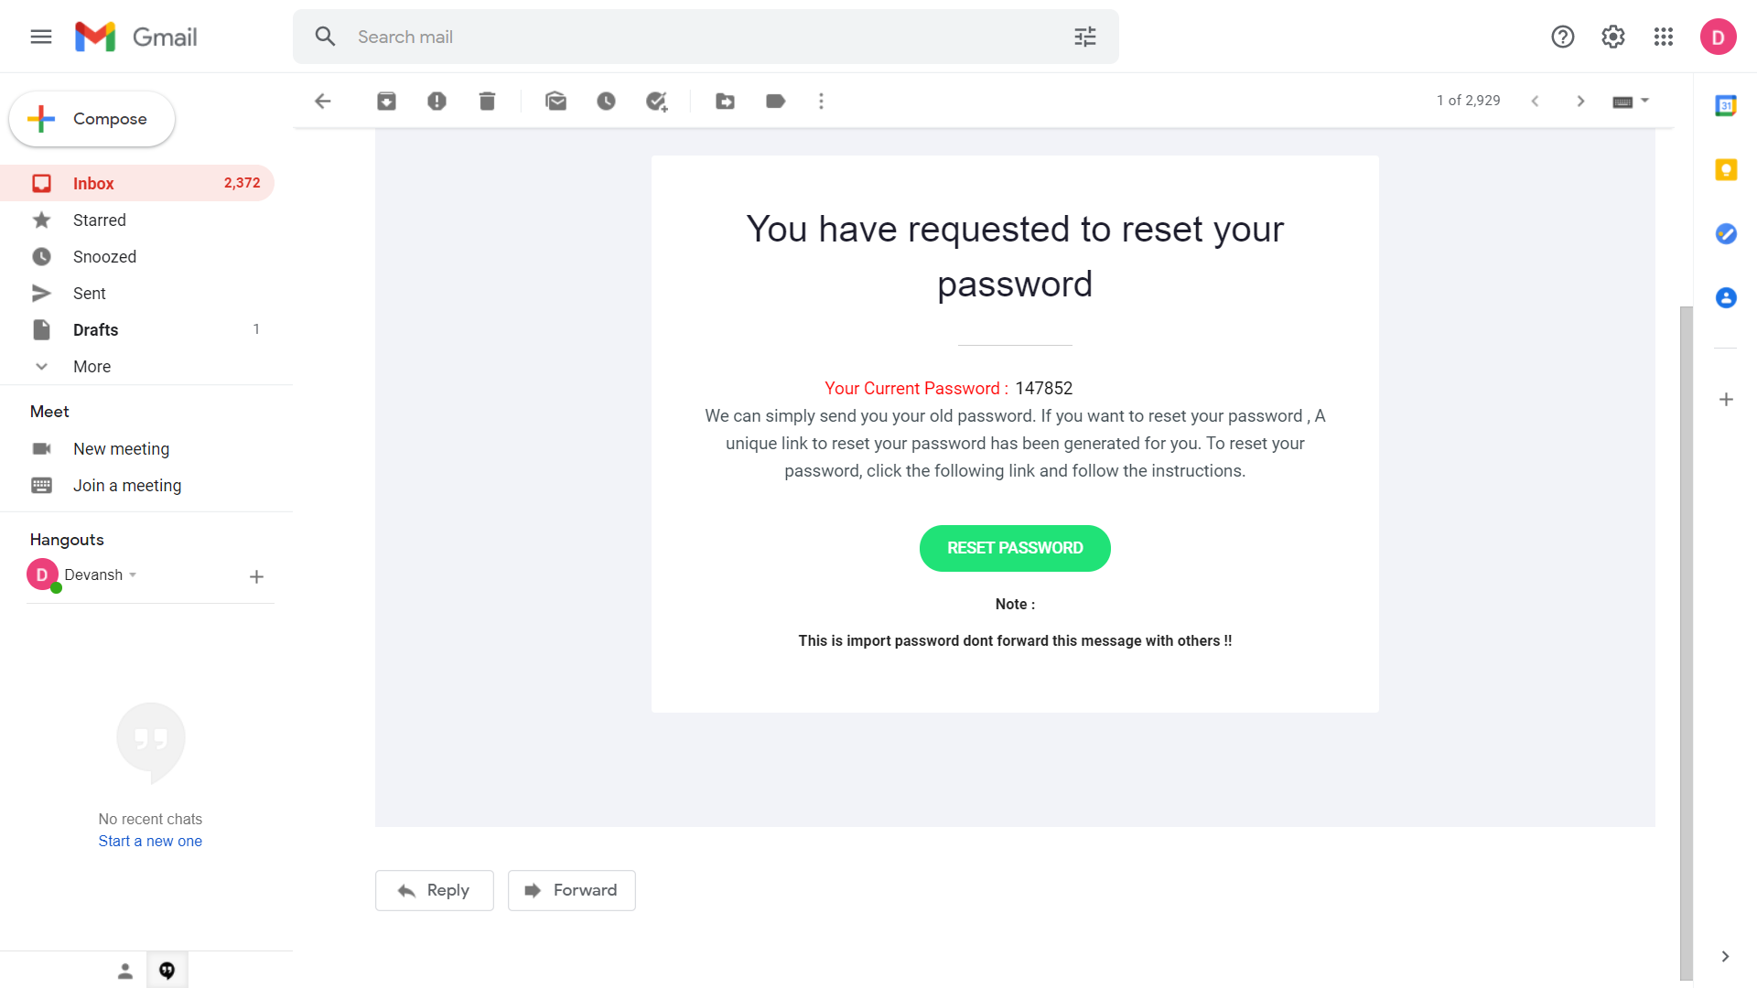
Email sent for lost password

Slide 45

Welcome page after login

Slide 46
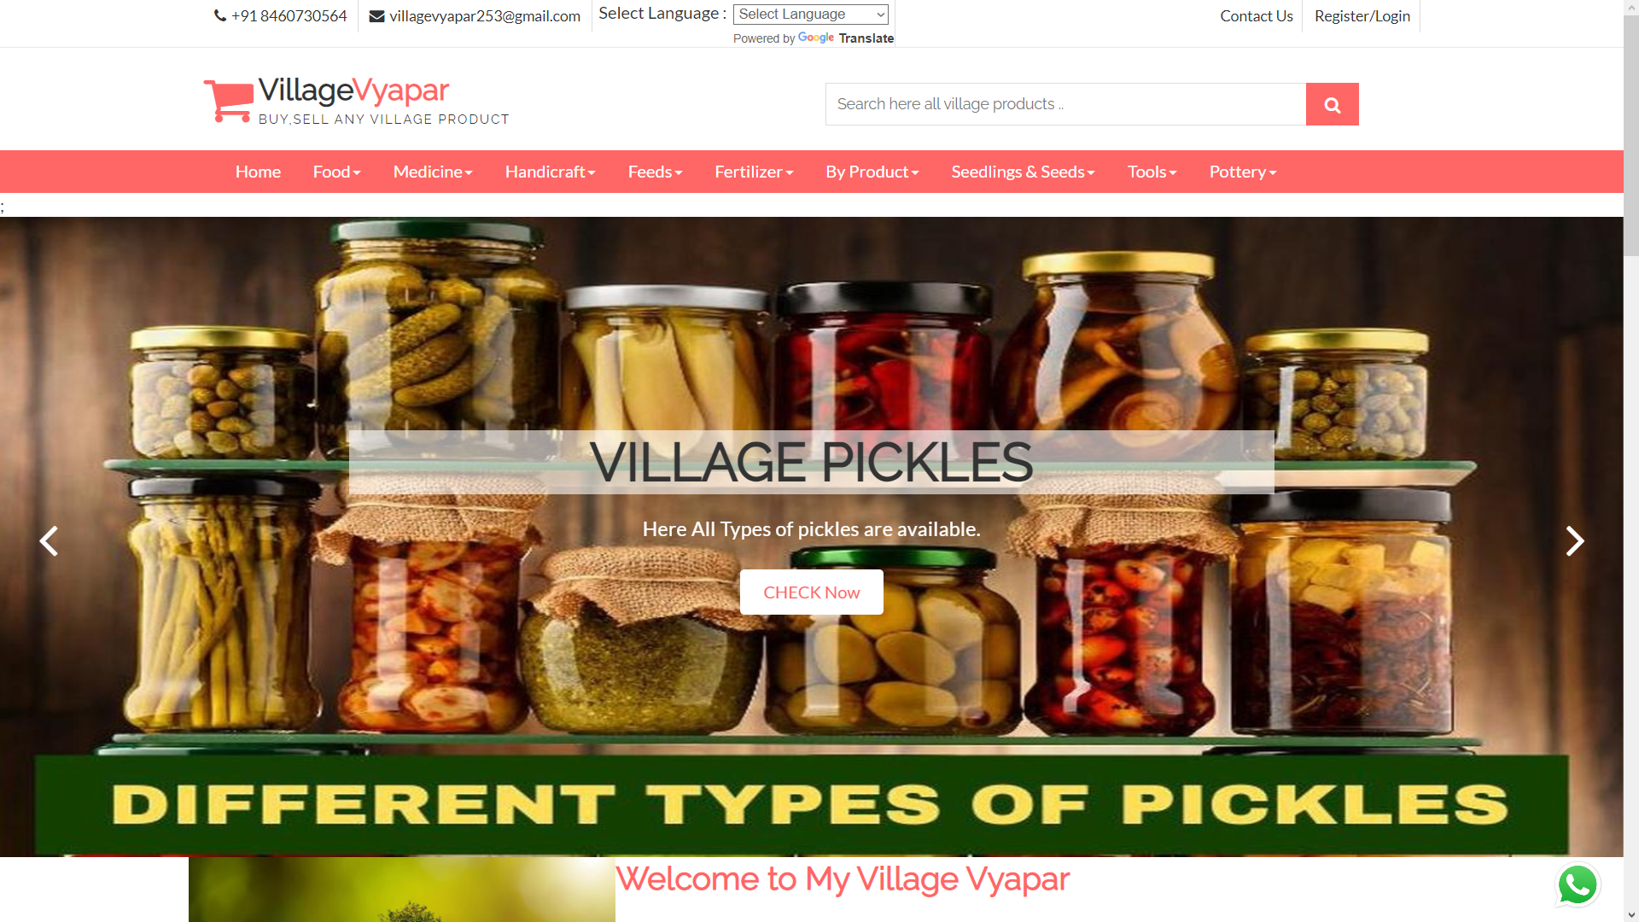
Welcome page

Slide 47
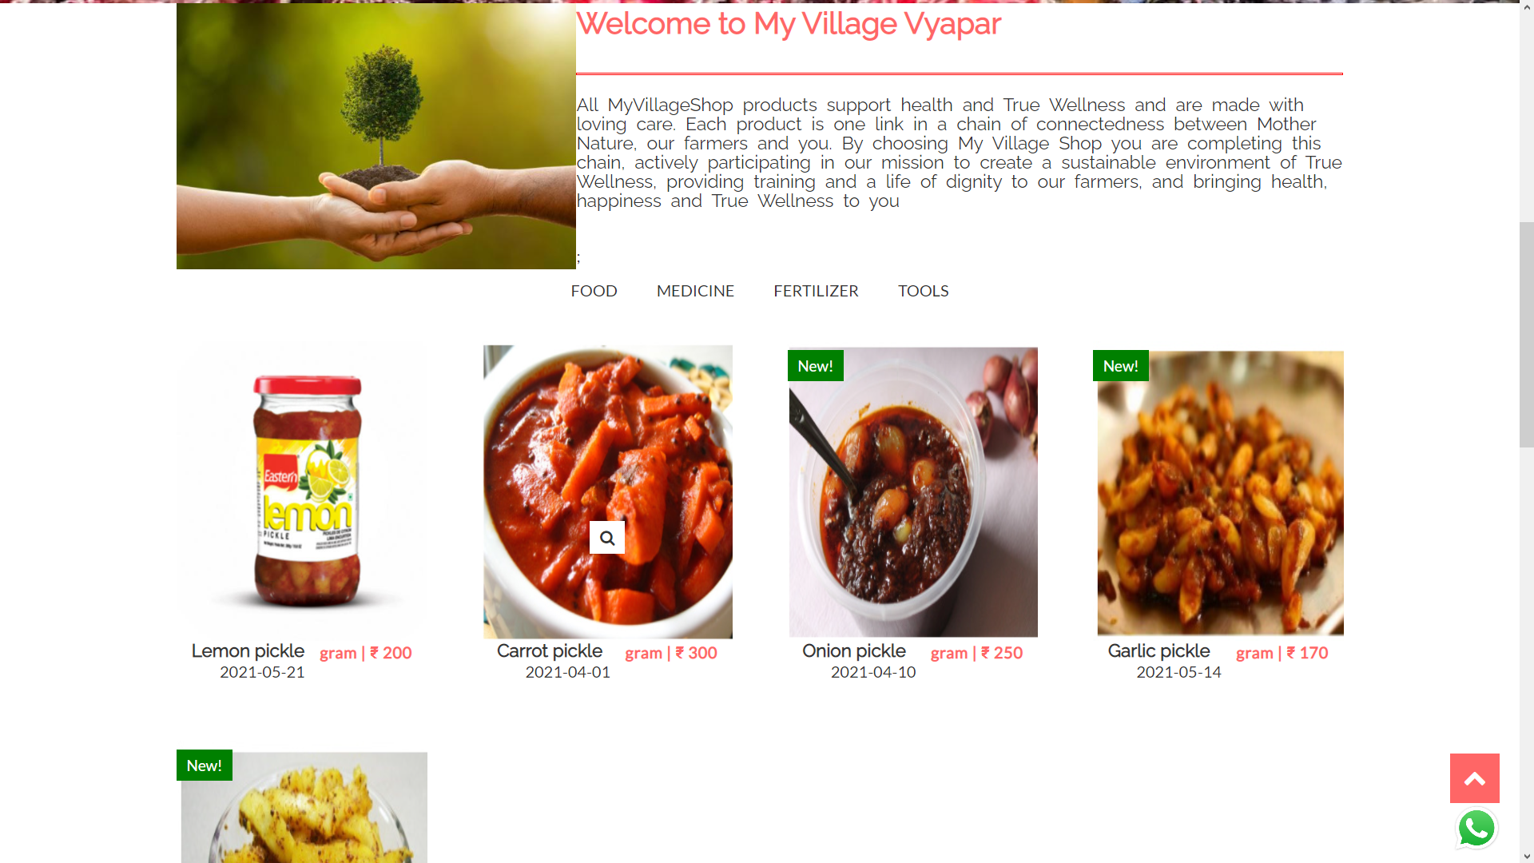
Welcome page

Slide 48
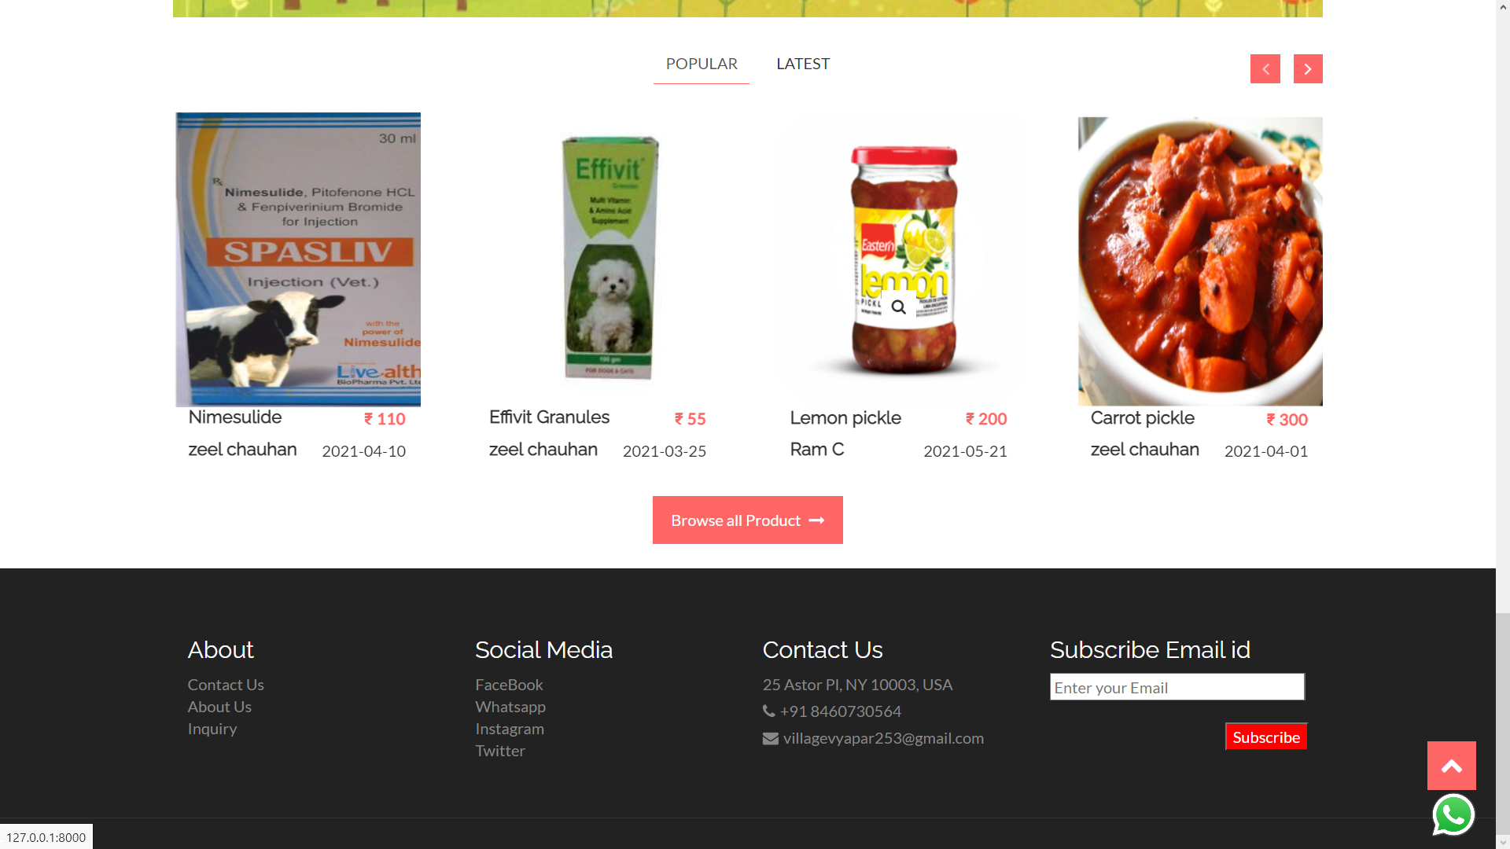
Welcome page Popular products

Slide 49
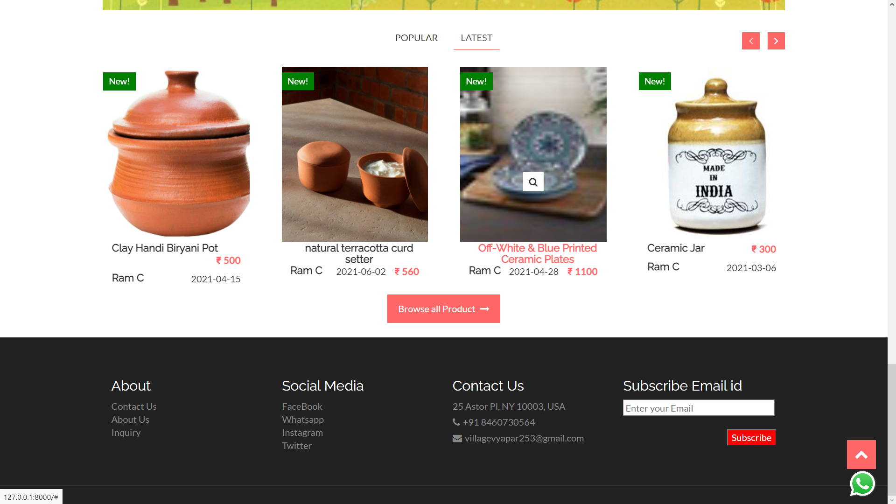
Welcome page Latest products

Slide 50
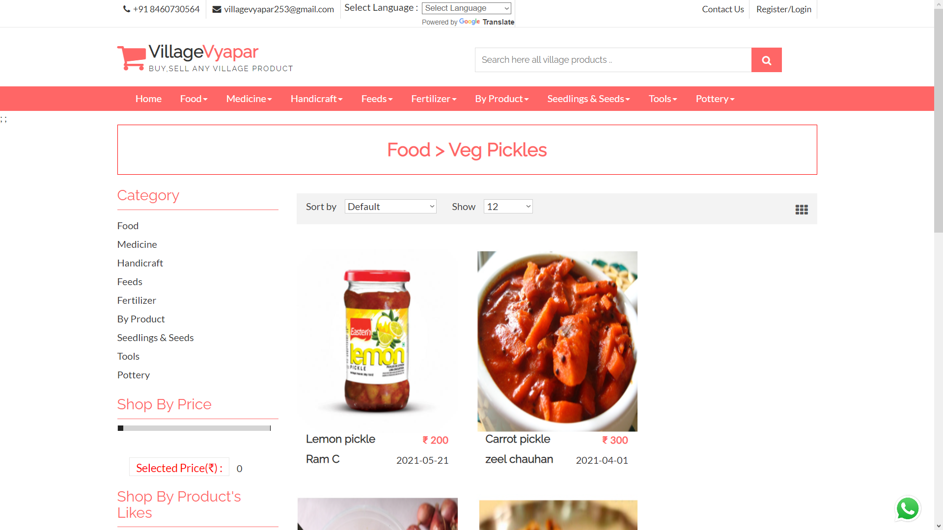
Products within subcategories

Slide 51
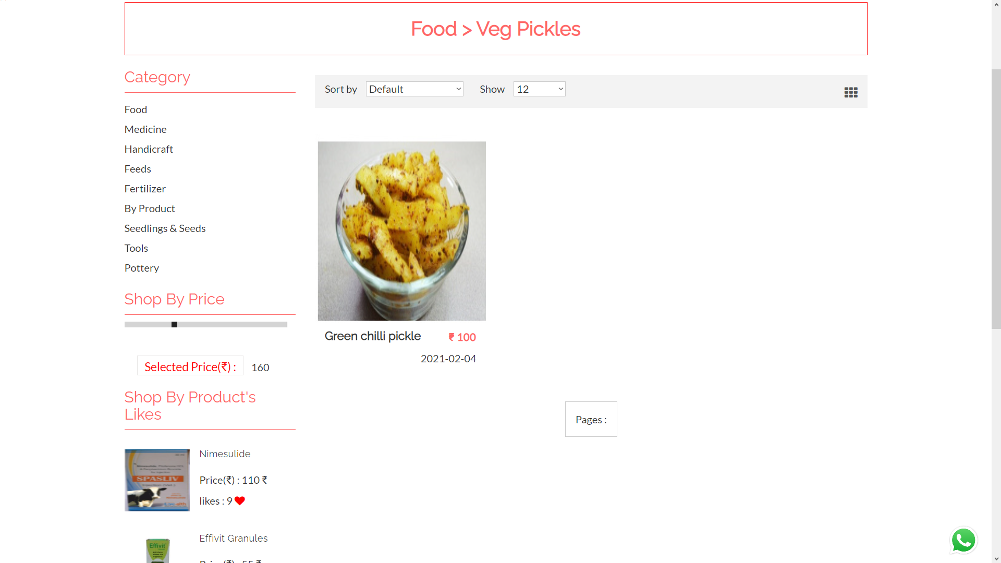
Products limited with price

Slide 52
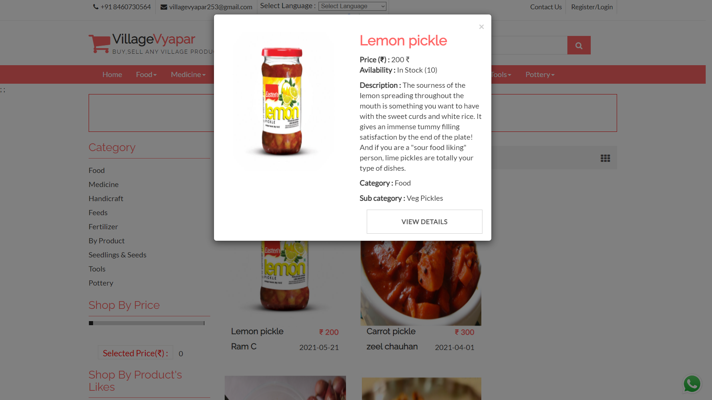
Product detail dialogue box

Slide 53
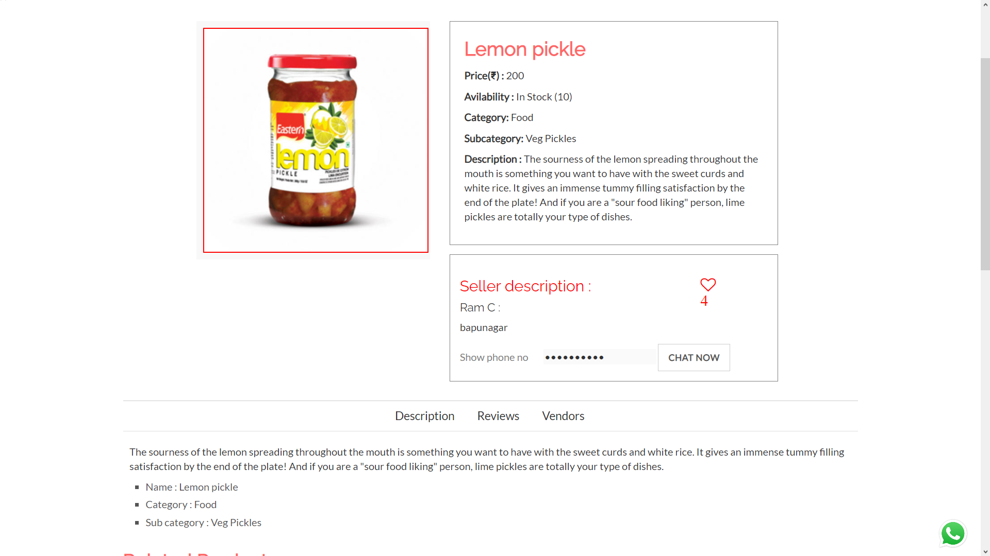
Product details

Slide 54
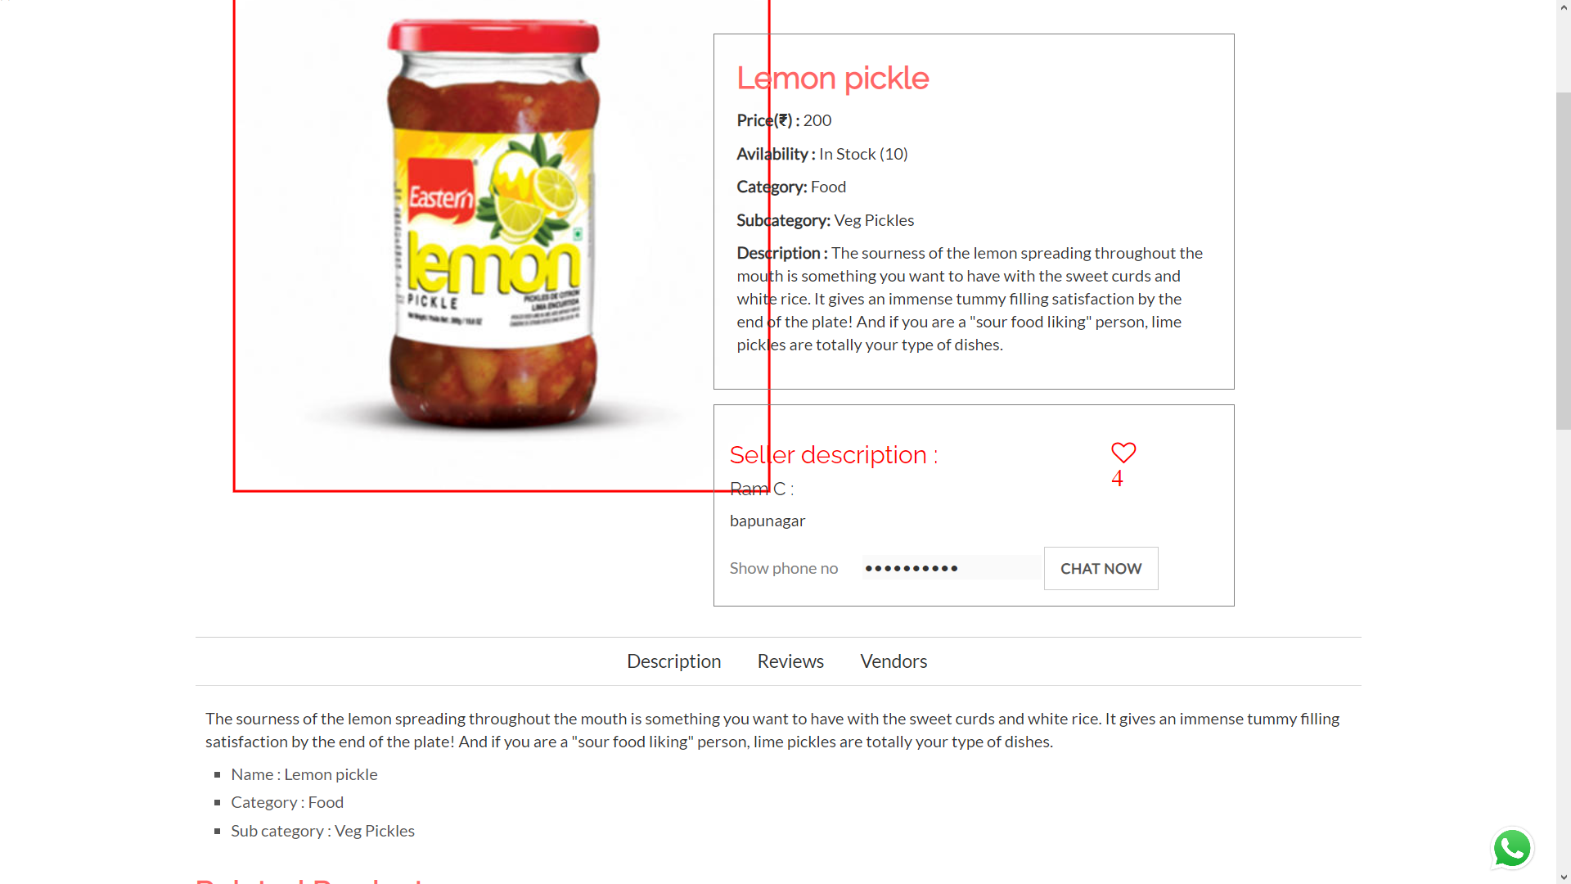
Product image zoomed

Slide 55
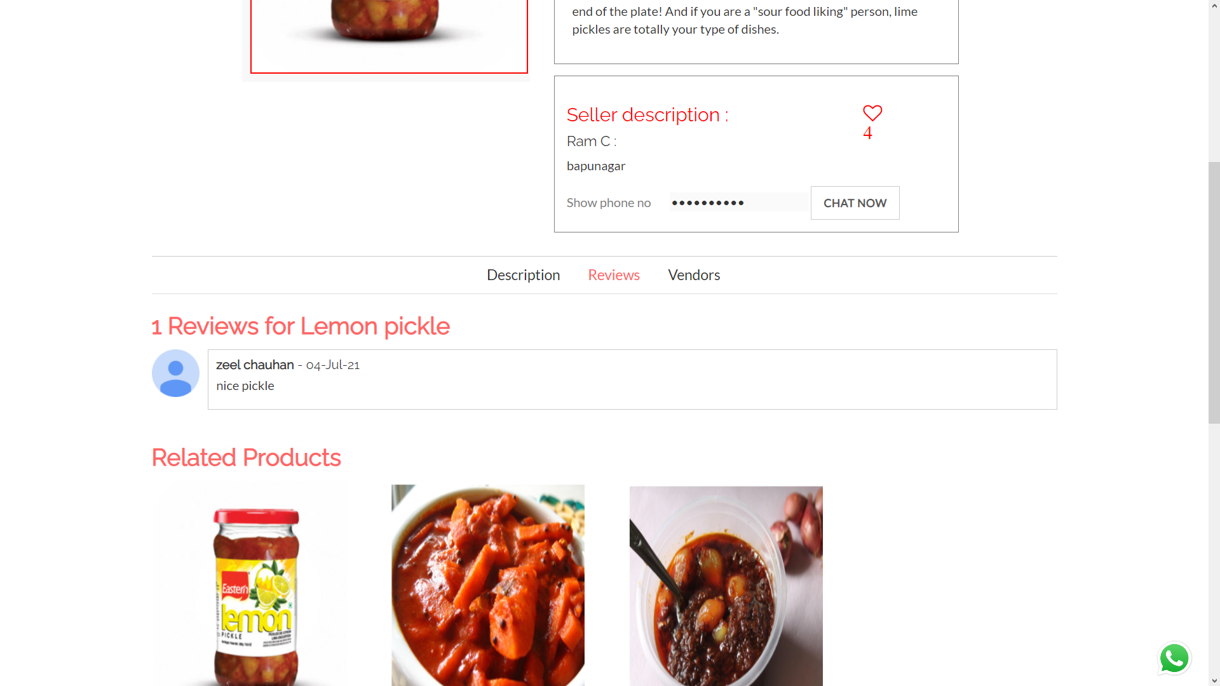
Product review

Slide 56
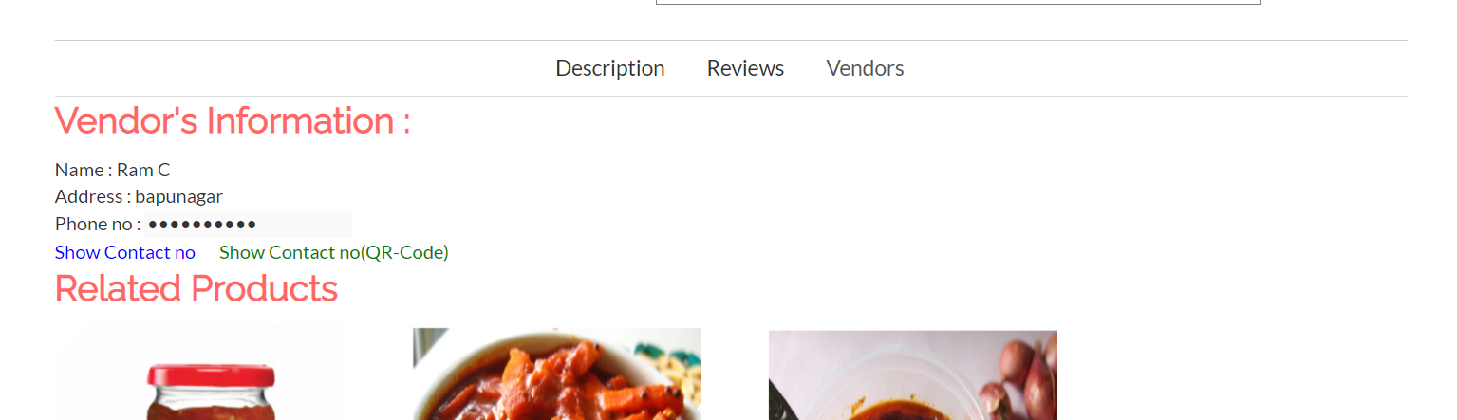
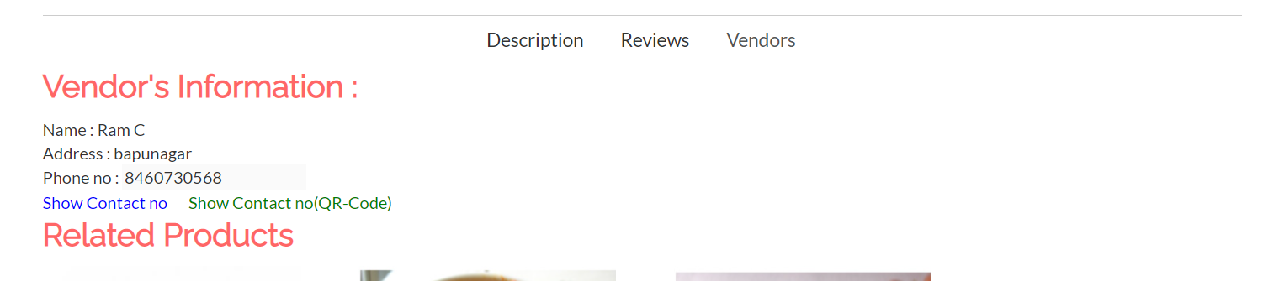
Vendor info 1

Slide 57
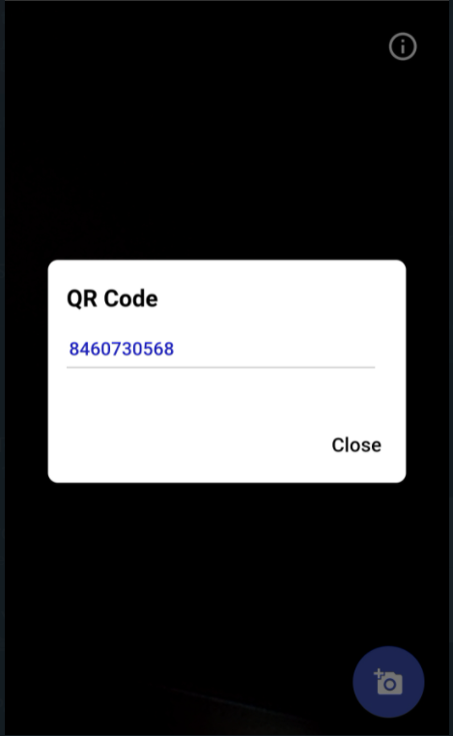
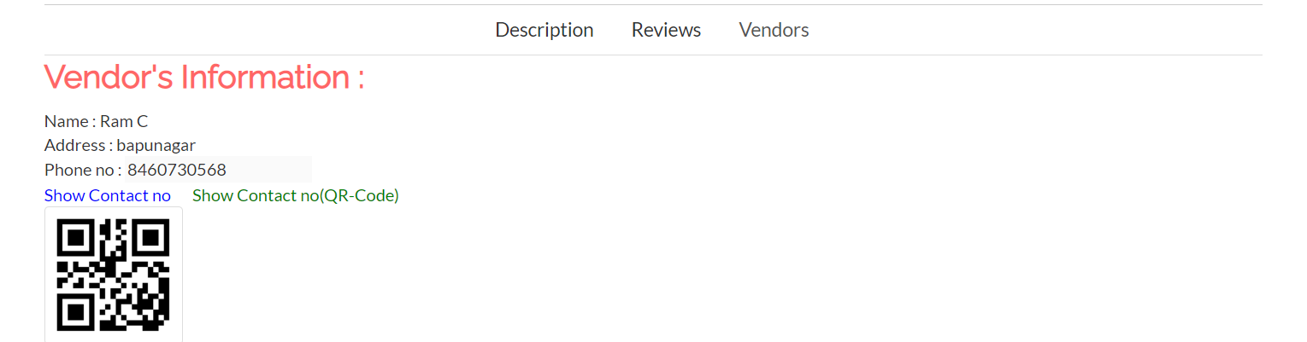
Vendor info 2

Slide 58
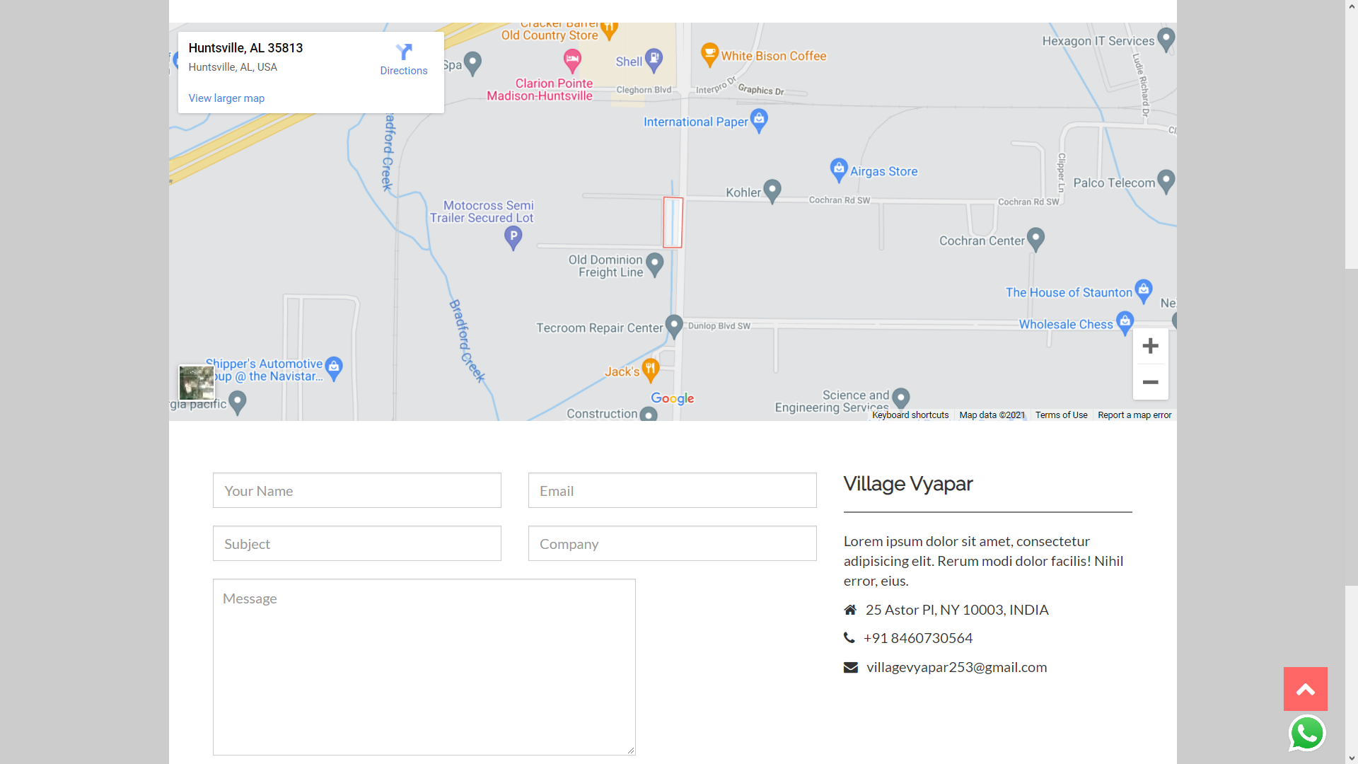
Contact us

Slide 59
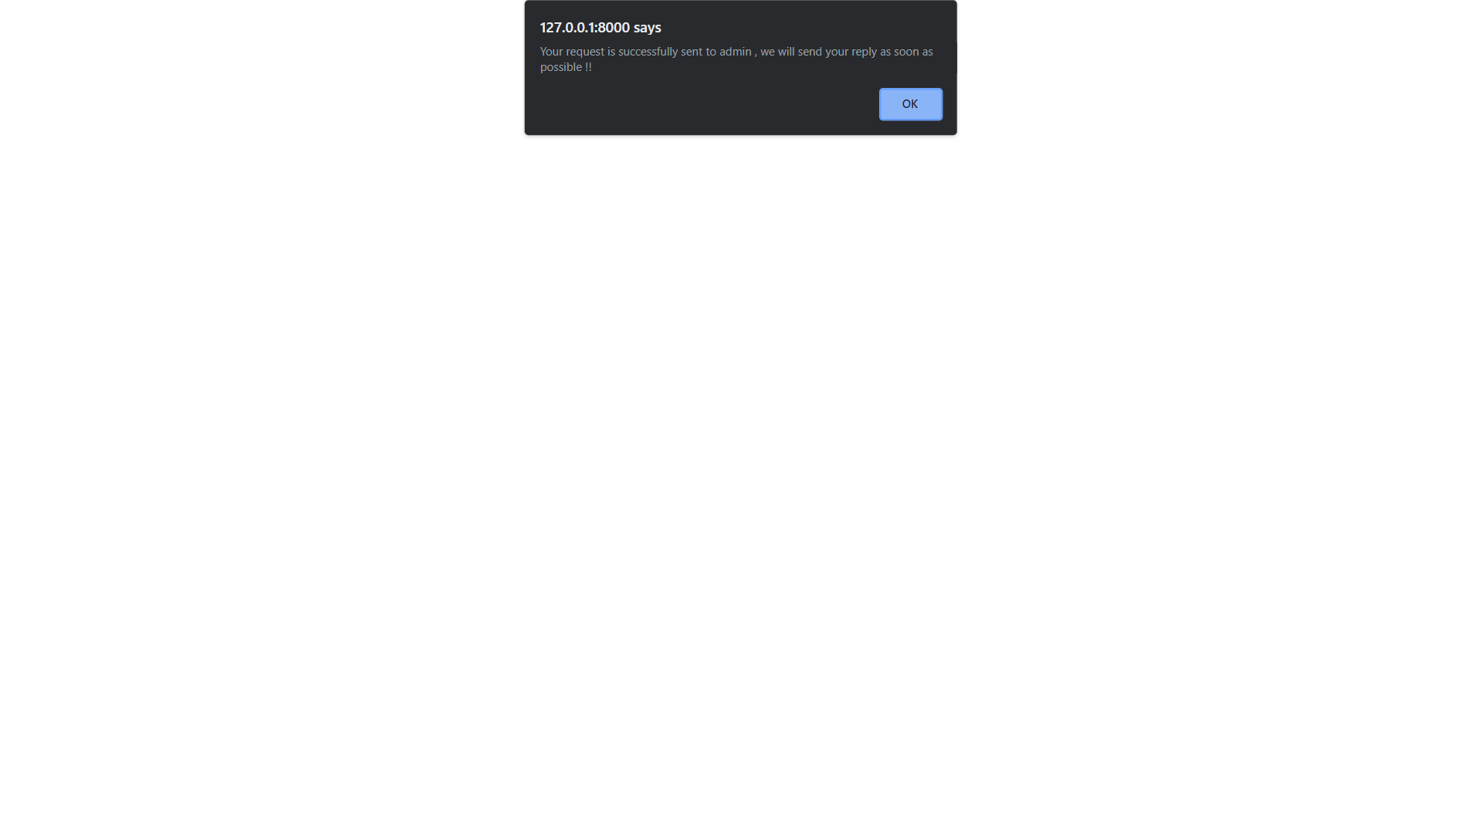
Inquiry asked

Slide 60
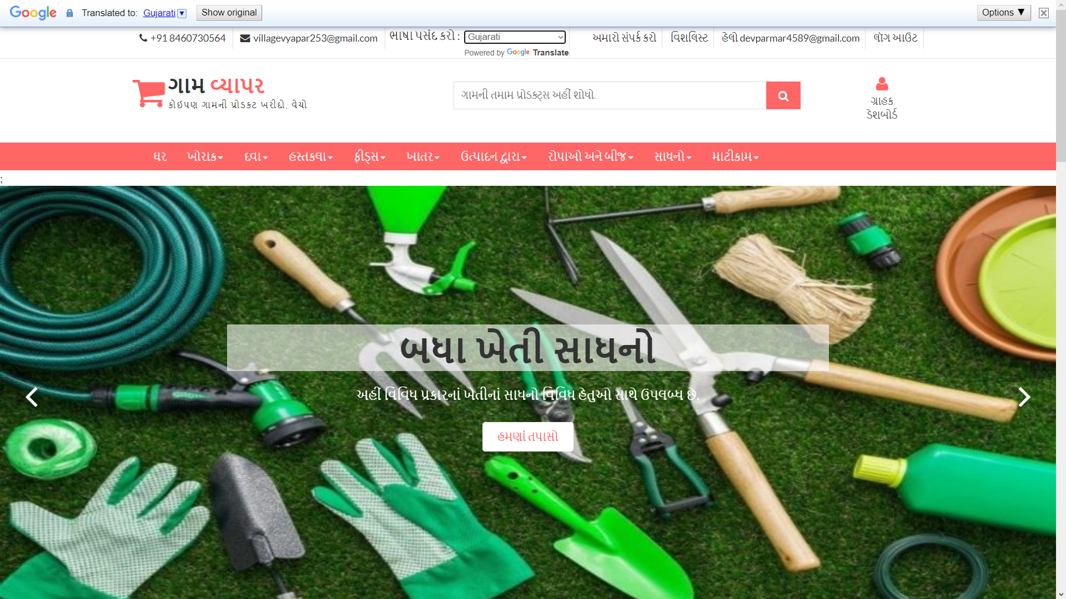
Language changes

Slide 61
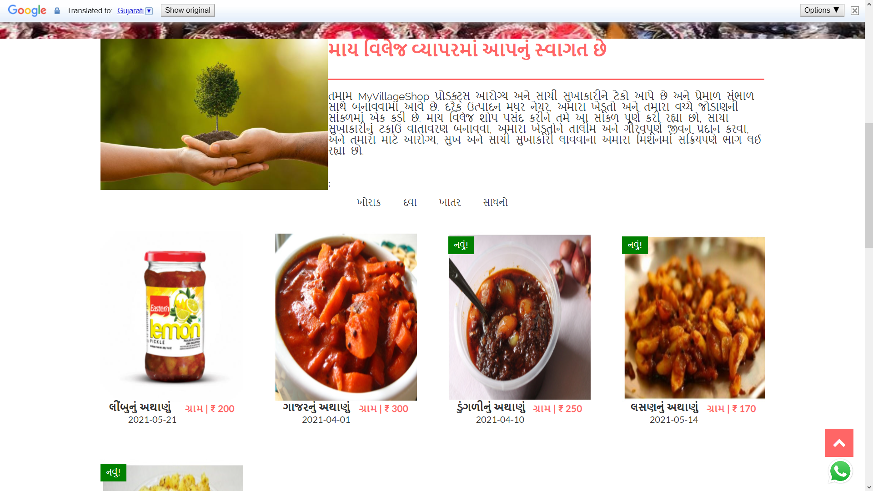
Language changes

Slide 62
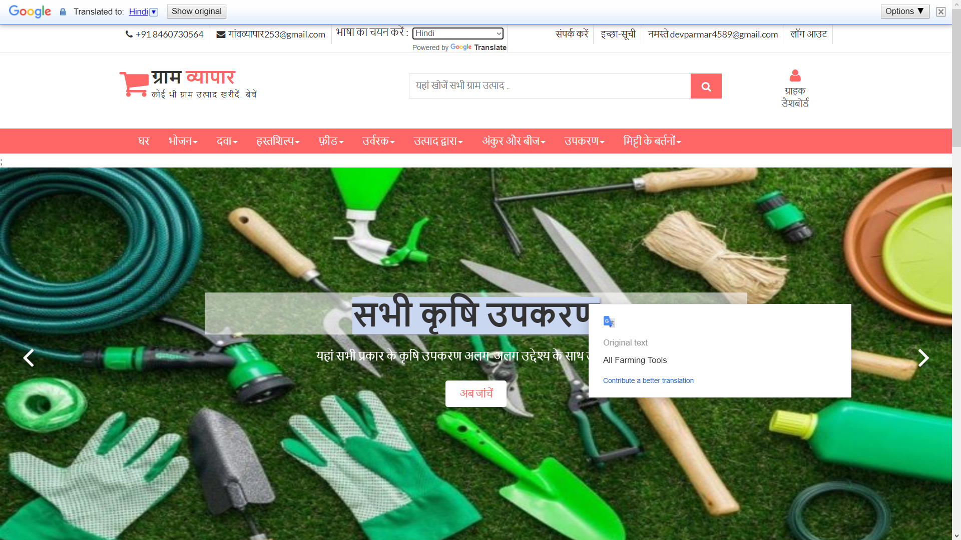
Language changes

Slide 63
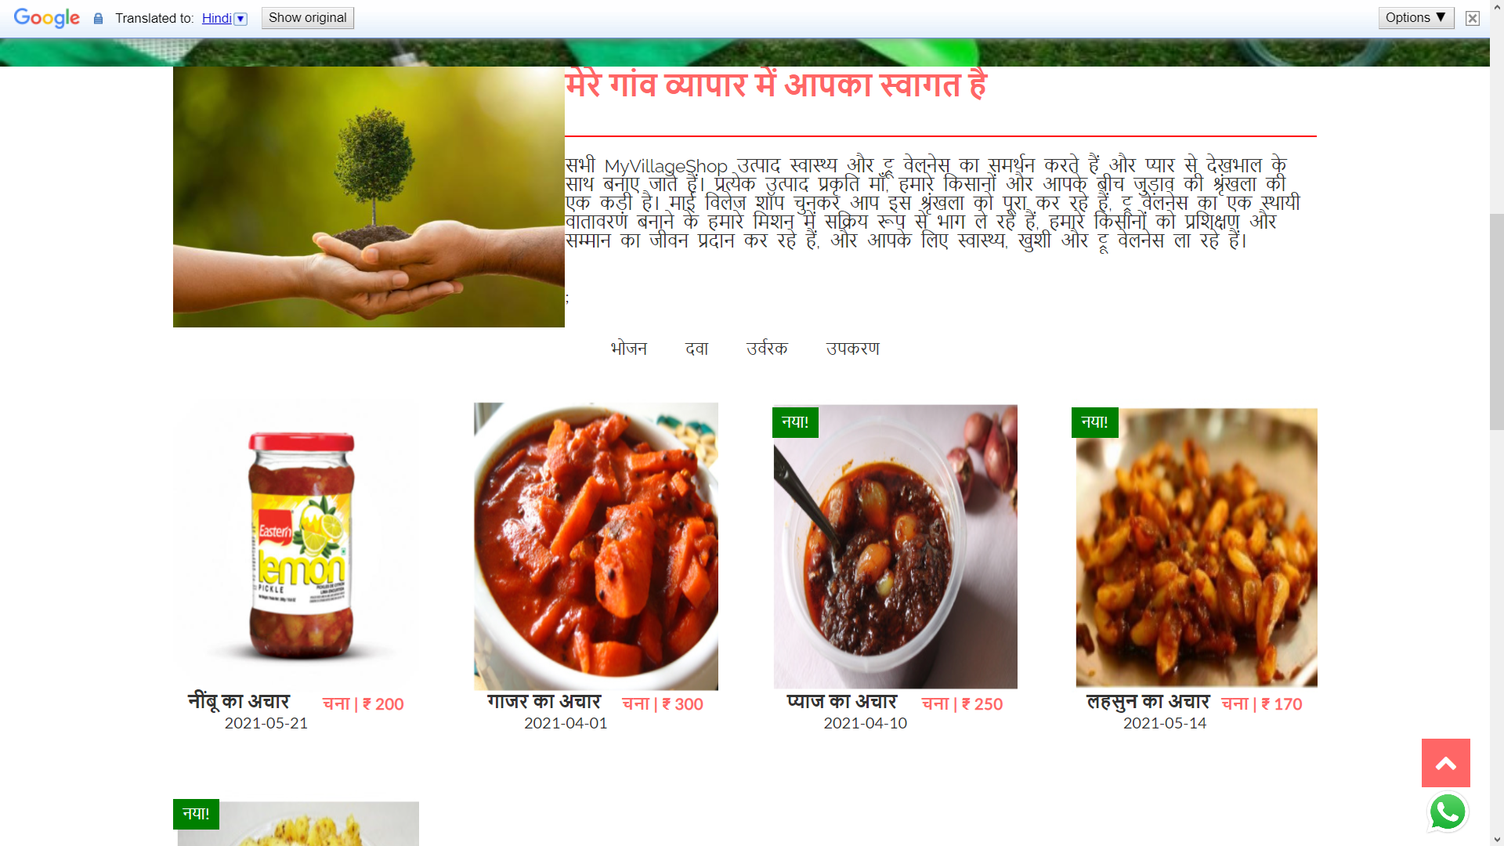
Language changes

Slide 64
Login

Slide 65
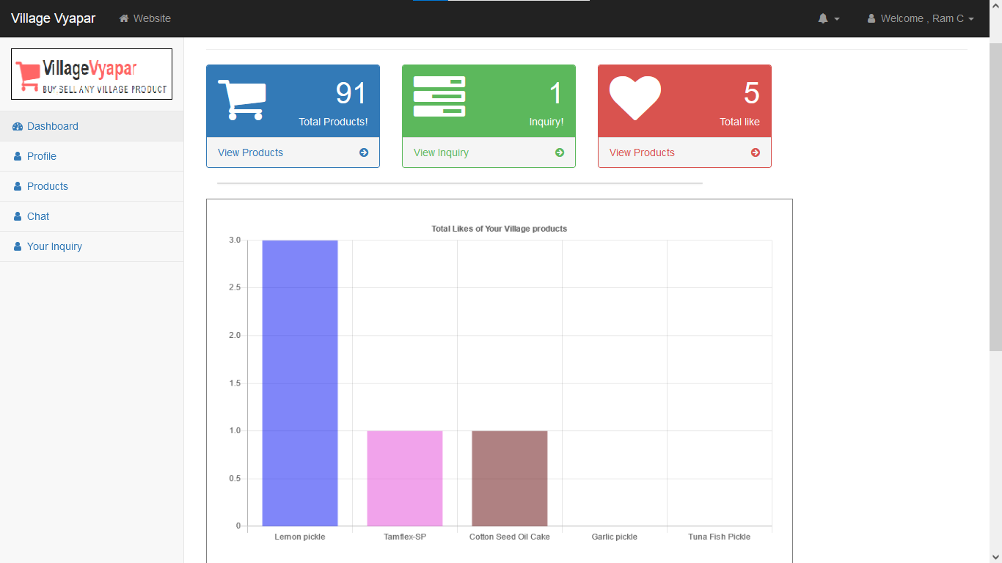
Customer Dashboard

Slide 66
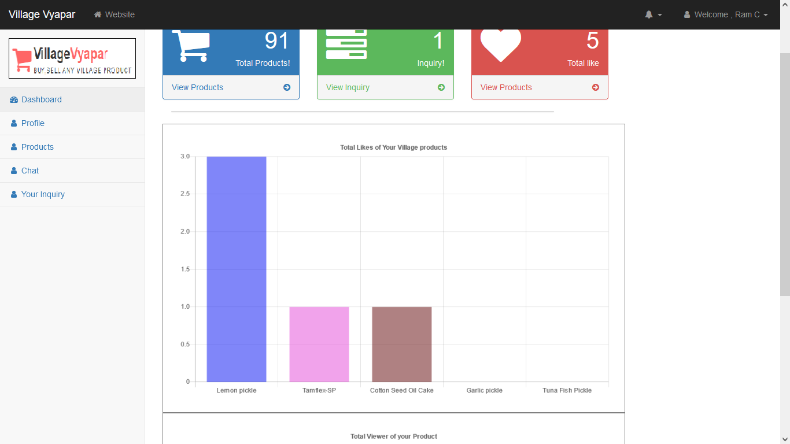
Total Likes of customer products

Slide 67
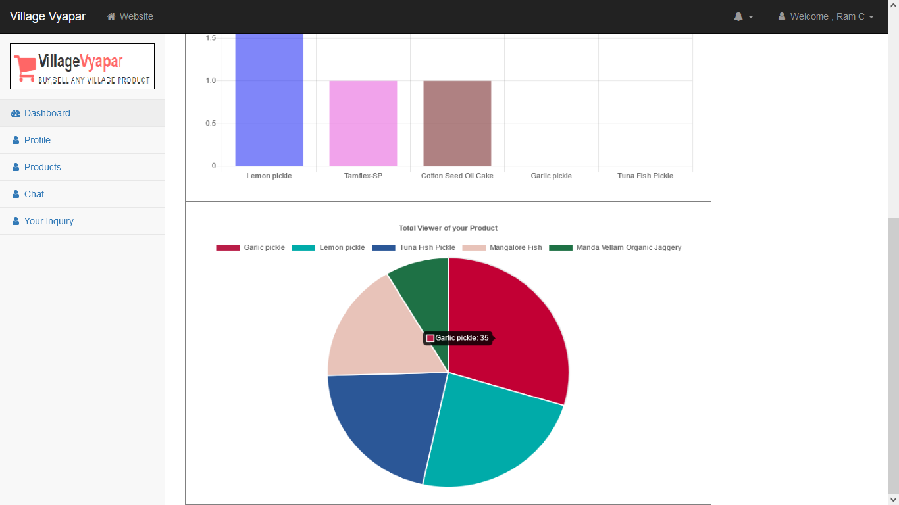
Total Viewer of customer products

Slide 68
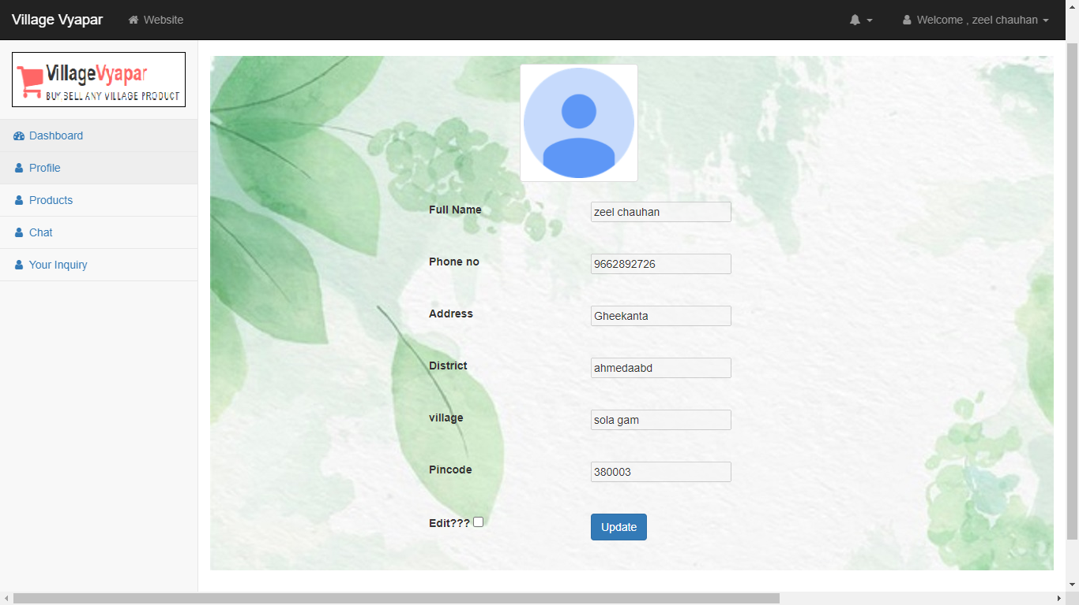
Customer Profile

Slide 69
Update Customer Profile

Slide 70
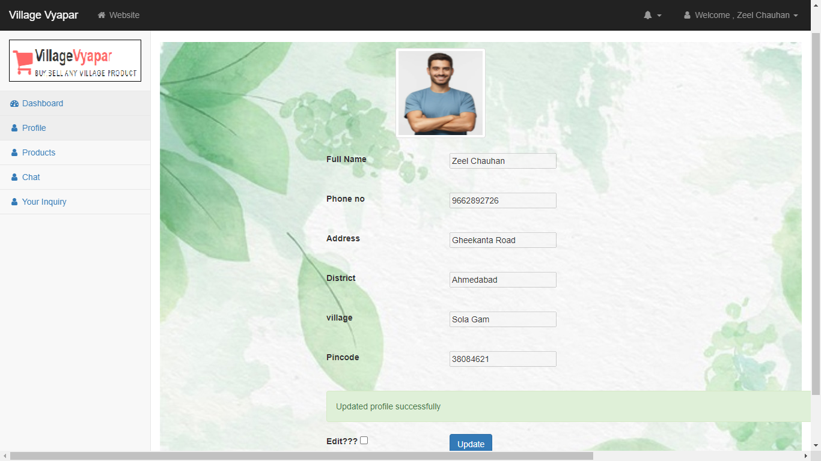

Slide 71
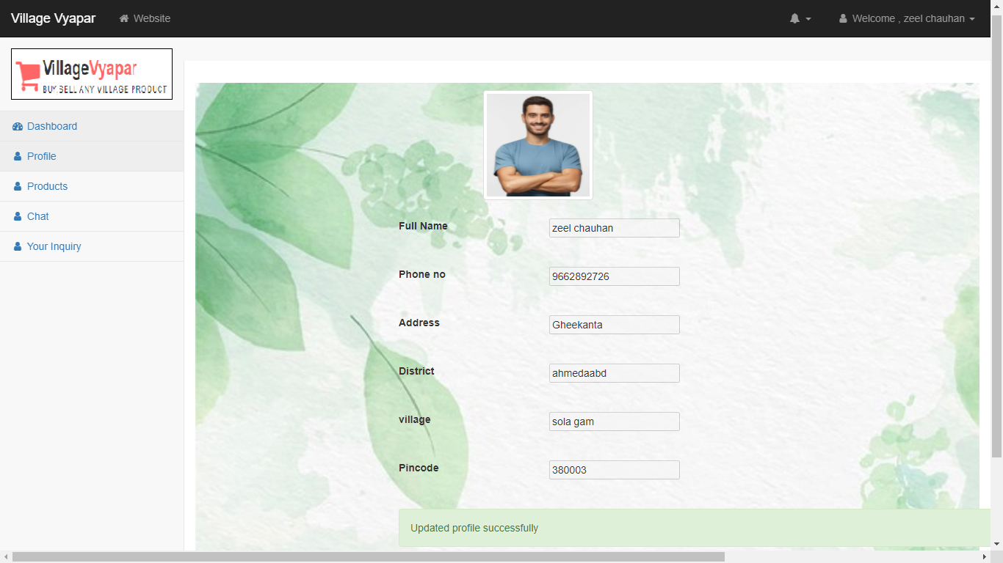

Slide 72
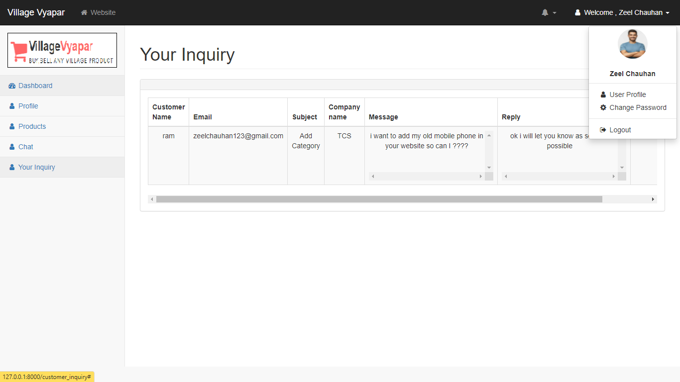

Slide 73
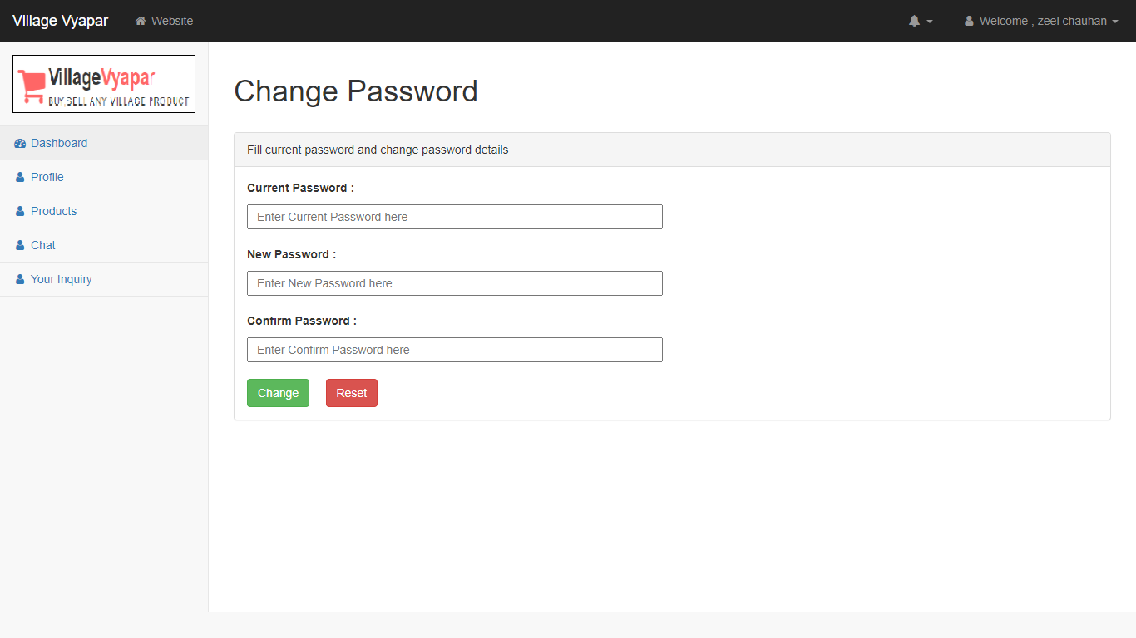
Change Password

Slide 74
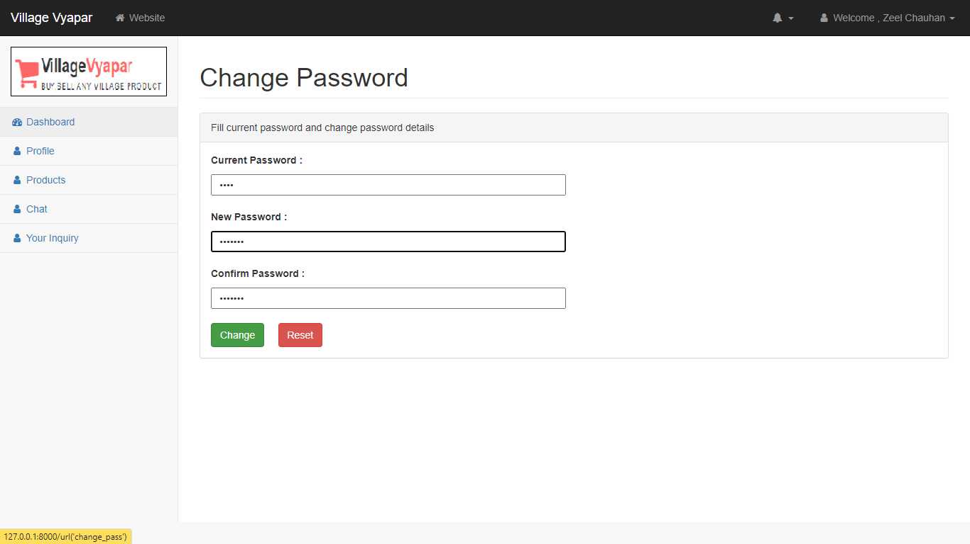

Slide 75
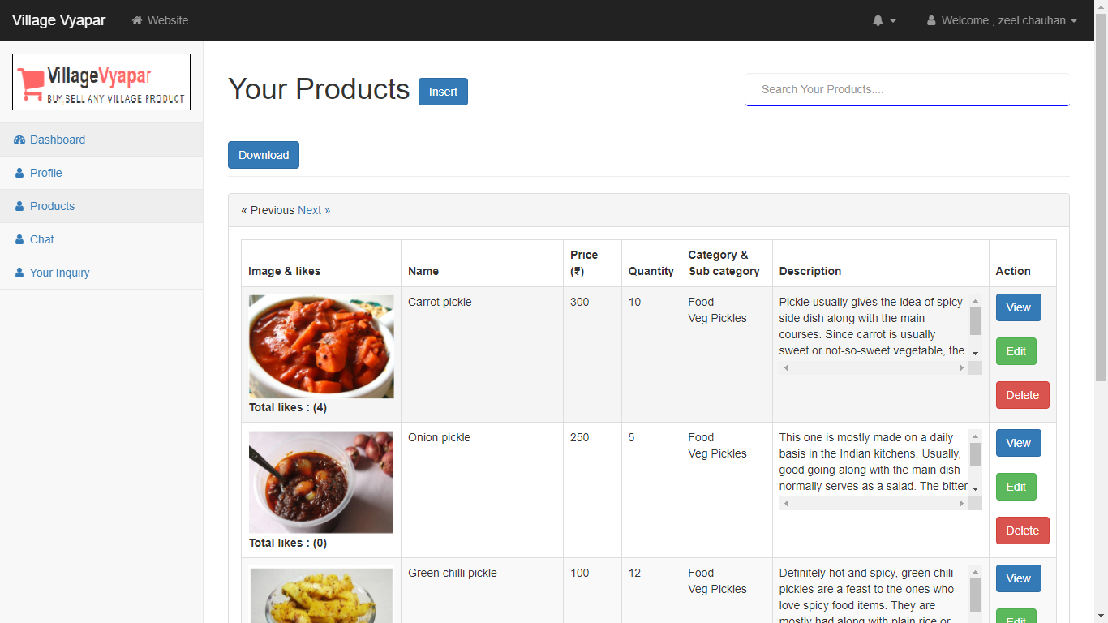
View Products

Slide 76
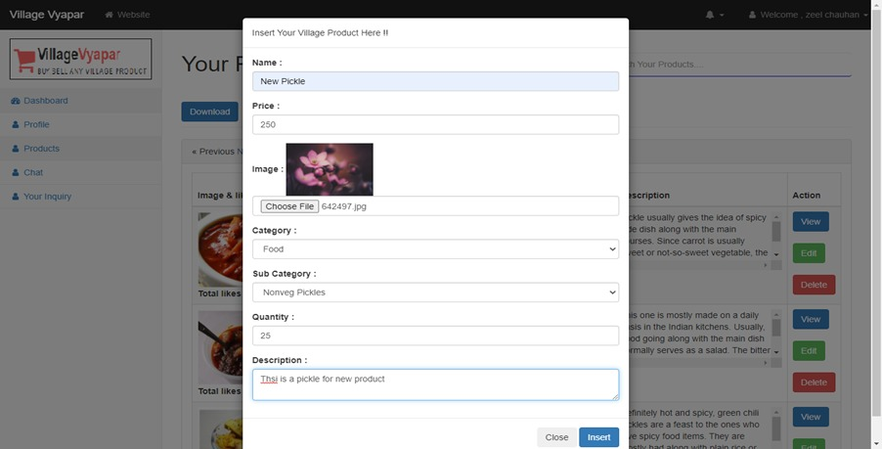
Insert Product

Slide 77
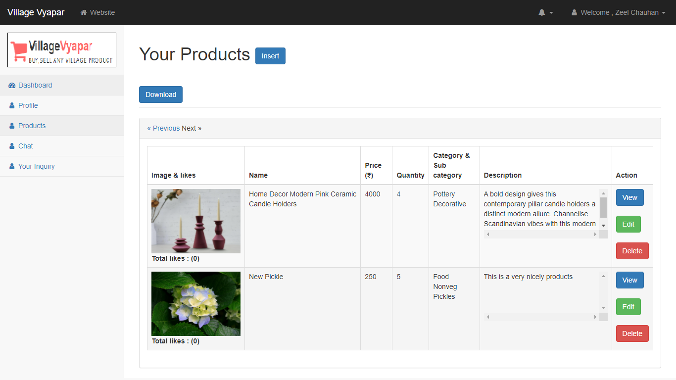
Product Inserted

Slide 78
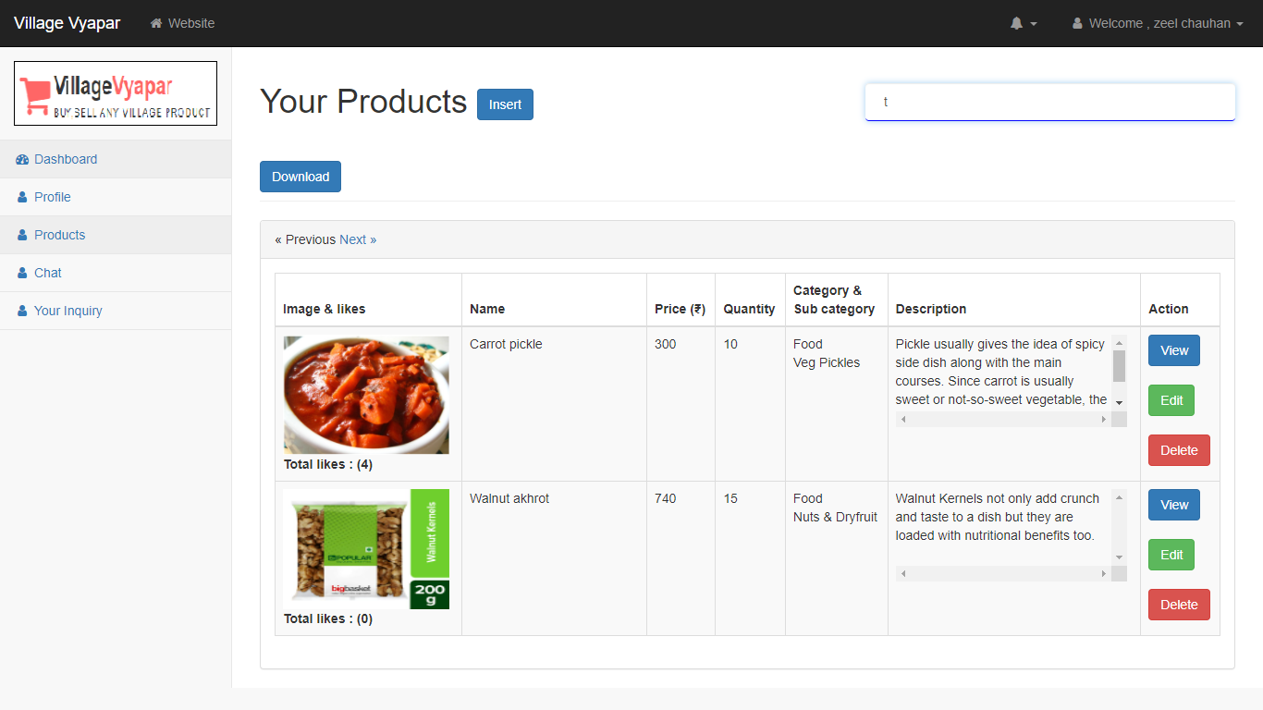
Search Products

Slide 79
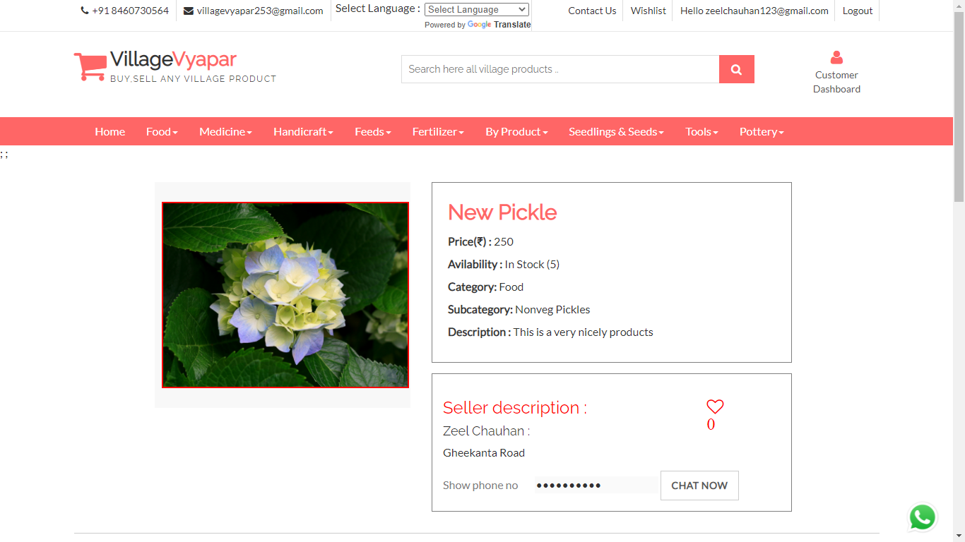
View Product

Slide 80
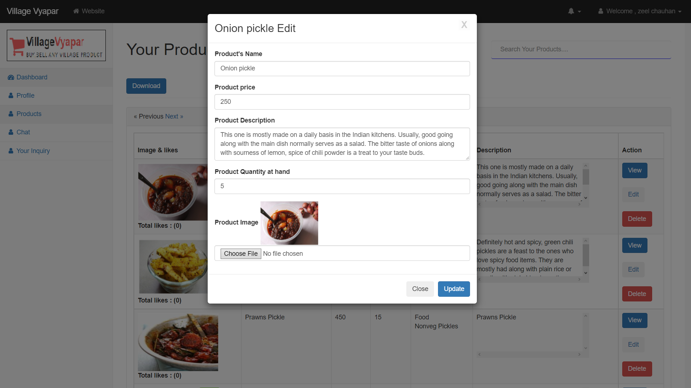
Edit Product details

Slide 81
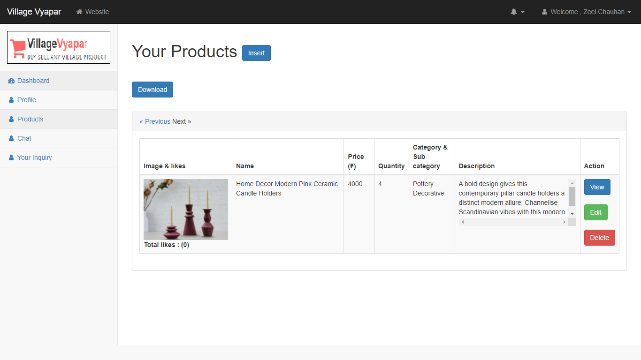
Delete Product

Slide 82
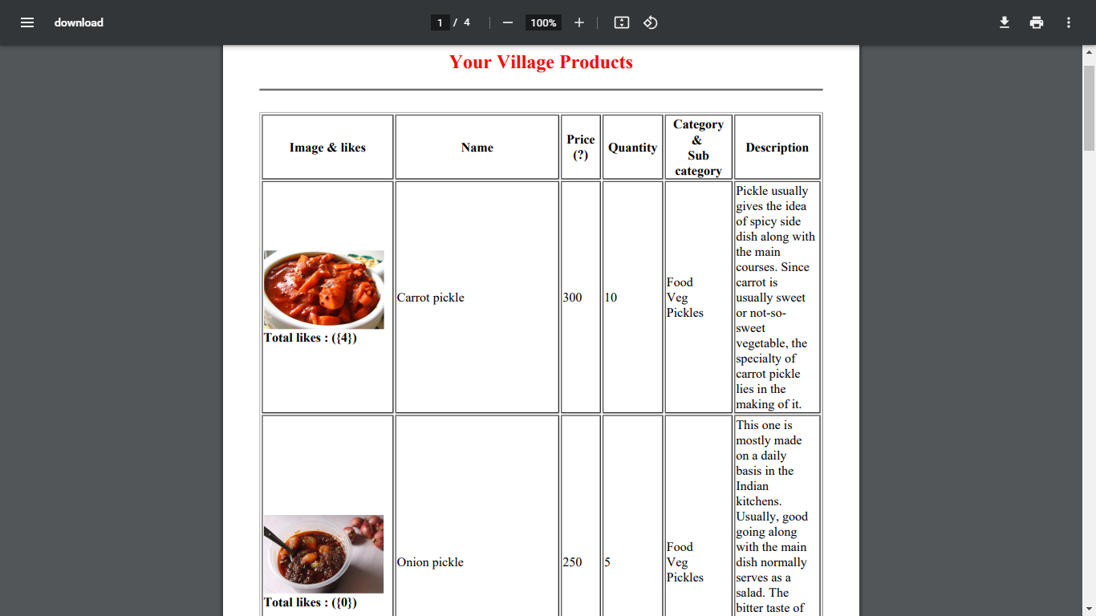
Download Product (Pdf)

Slide 83
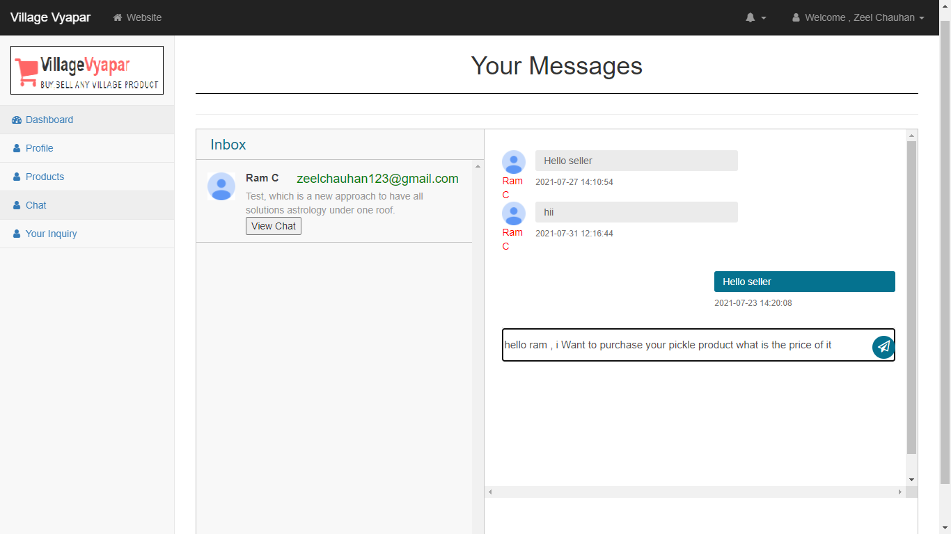
Chat bot

Slide 84
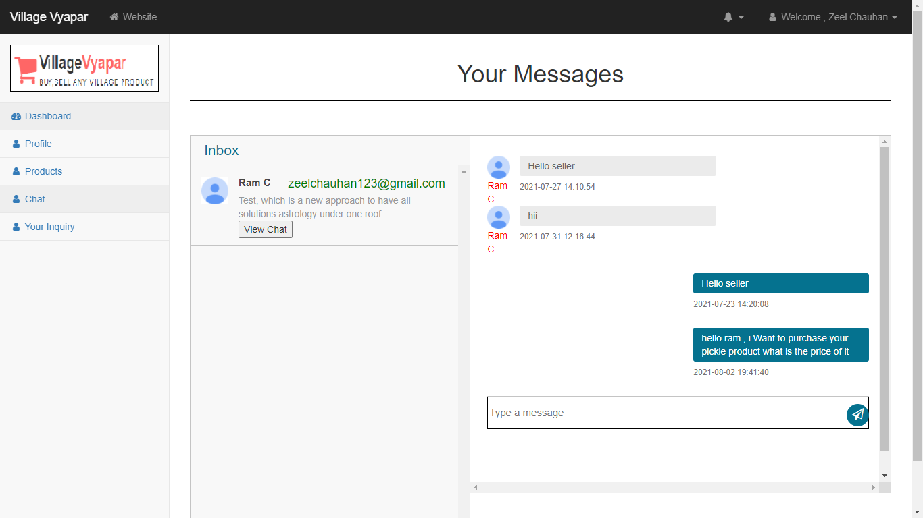

Slide 85
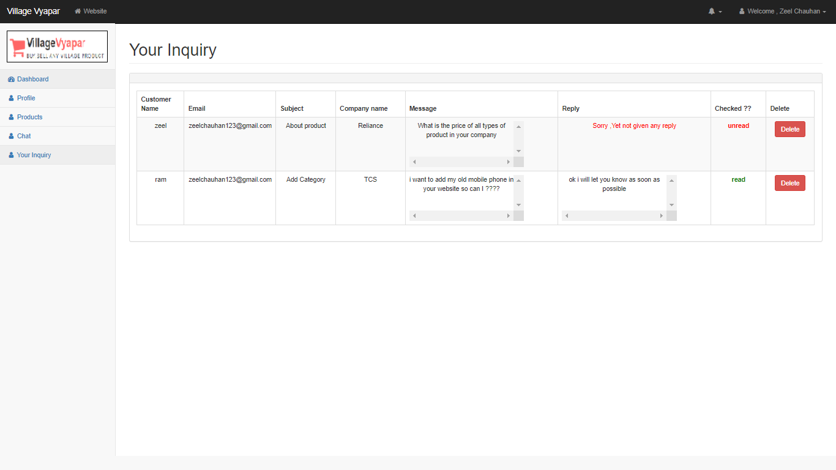
Inquiry

Slide 86
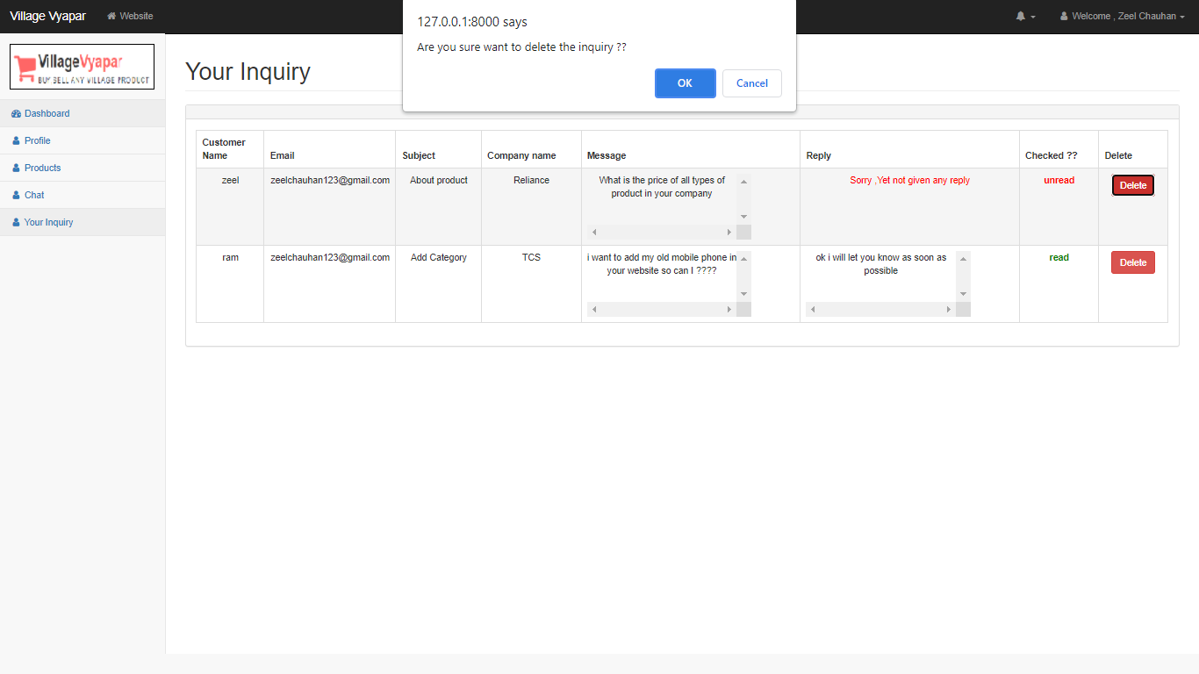
Delete Inquiry

Slide 87


Slide 88
3
Screen-shots (Admin)

Slide 89

Admin-login Page

Slide 90

Validate Credential

Slide 91

Invalid Login-credential

Slide 92

After Successful Login -Dashboard

Slide 93

Show Product detail menu

Slide 94

Show Categories

Slide 95

Add Category

Slide 96

After Add New Category

Slide 97

Edit Category

Slide 98

After Successfully Edit Category

Slide 99

Delete Category

Slide 100

After Delete Sample Category

Slide 101

Show Sub-Category

Slide 102

Add Sub-Category

Slide 103

After Add New Sub-Category

Slide 104

Delete Sub-Category

Slide 105

After Delete Sub-Category

Slide 106

Shows Products

Slide 107

View Product

Slide 108

Delete Sample Product

Slide 109

After Delete Sample Product

Slide 110

Search Product

Slide 111

Show User-details Menu

Slide 112

View customer list

Slide 113

Search Customer

Slide 114

View Admin list

Slide 115

Show Inquiry

Slide 116

Reply To An inquiry

Slide 117

After Reply To An inquiry

Slide 118

Show Admin Menu

Slide 119

Edit Admin profile

Slide 120

After Edit Admin Profile

Slide 121

Admin Forgot Password 1

Slide 122

Admin Forgot Password 2

Slide 123

Security Code on Mail

Slide 124

After entering security code and detail

Slide 125

Show Report Menu

Slide 126

Show Customer Details

Slide 127

Show Customer Product Details

Slide 128

Admin Logout

Slide 129
After Logout

Slide 130
3
System Design

Slide 131
Use Case Diagram

Slide 132
Class Diagram

Slide 133
Interaction Diagram

Slide 134
Activity Diagram

Slide 135
Data Dictionary

Slide 136
4
Development

Slide 137
5
Proposed Enhancement

Slide 138
6
Conclusion

Slide 139
7
Bibliography

Slide 140
CONTENTS
1
4
ADD THE SLIDE TITLE HERE
ADD THE SLIDE TITLE HERE
Please add a comment here
Please add a comment here
2
5
ADD THE SLIDE TITLE HERE
ADD THE SLIDE TITLE HERE
Please add a comment here
Please add a comment here
3
6
ADD THE SLIDE TITLE HERE
ADD THE SLIDE TITLE HERE
Please add a comment here
Please add a comment here

Slide 141
1
ADD THE SLIDE TITLE HERE
PLEASE ADD SLIDE SUBTITLE HERE

Slide 142



Please add title in here
ADD
KEY
WORDS
Please add text here, according to the need to adjust the font and font size. Please add text here, according to the need to adjust the font and font size.
Please add text here, according to the need to adjust the font and font size. Please add text here, according to the need to adjust the font and font size.
Please add text here, according to the need to adjust the font and font size.
ADD
KEY
WORDS
ADD
KEY
WORDS
Please add title in here
Please add text here, according to the need to adjust the font and font size.

Slide 143
Please add title in here
Please add text here, according to the need to adjust the font and font size. Please add text here.
Please add text here, according to the need to adjust the font and font size. Please add text here, according to the need to adjust the font and font size.
1 ADD KEY WORDS
Please add text here, according to the need to adjust the font and font size. Please add text here.
2 ADD KEY WORDS
Please add text here, according to the need to adjust the font and font size. Please add text here.
3 ADD KEY WORDS
Please add text here, according to the need to adjust the font and font size. Please add text here.
4 ADD KEY WORDS
Please add text here, according to the need to adjust the font and font size. Please add text here.
5 ADD KEY WORDS

Slide 144

Please add title in here
Please add text here, according to the need to adjust the font and font size. Please add text here, according to the need to adjust the font and font size.
Please add text here, according to the need to adjust the font and font size. Please add text here, according to the need to adjust the font and font size.
Please add title in here
Please add text here, according to the need to adjust the font and font size. Please add text here.

Slide 145
Please add text here, according to the need to adjust the font and font size, recommended justified form.
64%
50%
75%
ADD KEY WORDS
ADD KEY WORDS
ADD KEY WORDS
Please add text here, according to the need to adjust the font and font size.
Please add text here, according to the need to adjust the font and font size.
Please add text here, according to the need to adjust the font and font size.

Slide 146
ADD KEY WORDS
ADD KEY WORDS
Please add text here, according to the need to adjust the font and font size. Please add text here, according to the need to adjust the font and font size.
Please add text here, according to the need to adjust the font and font size. Please add text here, according to the need to adjust the font and font size.
Please add text here, according to the need to adjust the font and font size. Please add text here, according to the need to adjust the font and font size.
ADD KEY WORDS
Please add text here, according to the need to adjust the font and font size, recommended justified form. Please add text here, according to the need to adjust the font and font size.

Slide 147
10
Please add text here, according to the need to adjust the font and font size.
09
08
07
06
05
04
03
02
01
01
02
03
04
05
06
07
08
09
10
11
12
Please add text here, according to the need to adjust the font and font size, recommended justified form.

Slide 148
ADD KEY WORDS
ADD KEY WORDS
ADD KEY WORDS
Please add text here, according to the need to adjust the font and font size. Please add text here, according to the need to adjust the font and font size.
Please add text here, according to the need to adjust the font and font size. Please add text here, according to the need to adjust the font and font size.
Please add text here, according to the need to adjust the font and font size. Please add text here, according to the need to adjust the font and font size.
Please add text here, according to the need to adjust the font and font size. Please add text here, according to the need to adjust the font and font size.

Slide 149


Please add text here, according to the need to adjust the font and font size. Please add text here, according to the need to adjust the font and font size.
Please add text here, according to the need to adjust the font and font size. Please add text here, according to the need to adjust the font and font size.
Please add text here, according to the need to adjust the font and font size. Please add text here, according to the need to adjust the font and font size. Please add text here, according to the need to adjust the font and font size. Please add text here, according to the need to adjust the font and font size.

Slide 150
Please add title in here
Please add text here, according to the need to adjust the font and font size.
000T
000T
000T
000T
000T
000T
000T
000T
000T
000T
000T
000T
01
02
03
04
05
06
07
08
09
10
11
12
Please add text here, according to the need to adjust the font and font size. Please add text here, according to the need to adjust the font and font size.

Slide 151
Please add text here, according to the need to adjust the font and font size.
Please add text here, according to the need to adjust the font and font size.
ADD KEY WORDS
ADD KEY WORDS
ADD KEY WORDS
ADD KEY WORDS
Please add text here, according to the need to adjust the font and font size.
Please add text here, according to the need to adjust the font and font size.
Please add text here, according to the need to adjust the font and font size. Please add text here, according to the need to adjust the font and font size. Please add text here, according to the need to adjust the font and font size. Please add text here.

Slide 152
3
ADD THE SLIDE TITLE HERE
PLEASE ADD SLIDE SUBTITLE HERE

Slide 153
Please add text here, according to the need to adjust the font and font size.
ADD KEY WORDS
Please add text here, according to the need to adjust the font and font size. Please add text here, according to the need to adjust the font and font size.
Please add text here, according to the need to adjust the font and font size. Please add text here, according to the need to adjust the font and font size.
ADD
KEY WORDS
ADD KEY WORDS
ADD KEY WORDS
ADD KEY WORDS
Please add text here, according to the need to adjust the font and font size.
Please add text here, according to the need to adjust the font and font size. Please add text here, according to the need to adjust the font and font size. Please add text here, according to the need to adjust the font and font size.

Slide 154



Please add text here, according to the need to adjust the font and font size. Please add text here, according to the need to adjust the font and font size.
5 ADD KEY WORDS
5 ADD KEY WORDS
5 ADD KEY WORDS
Please add text here, according to the need to adjust the font and font size. Please add text here, according to the need to adjust the font and font size.
Please add text here, according to the need to adjust the font and font size. Please add text here, according to the need to adjust the font and font size.
Please add text here, according to the need to adjust the font and font size. Please add text here, according to the need to adjust the font and font size.

Slide 155

Please add title in here
Please add title in here
Please add text here, according to the need to adjust the font and font size.
Please add title in here
Please add text here, according to the need to adjust the font and font size.
Please add title in here
Please add text here, according to the need to adjust the font and font size.

Slide 156
Please add text here, according to the need to adjust the font and font size. Please add text here, according to the need to adjust the font and font size.
Please add text here, according to the need to adjust the font and font size. Please add text here, according to the need to adjust the font and font size.
Please add text here, according to the need to adjust the font and font size. Please add text here, according to the need to adjust the font and font size.
ADD KEY WORDS
ADD KEY WORDS
ADD KEY WORDS
Please add text here, according to the need to adjust the font and font size. Please add text here, according to the need to adjust the font and font size.

Slide 157
Please add title in here
Please add title in here
Please add text here, according to the need to adjust the font and font size. Please add text here, according to the need to adjust the font and font size.
Please add text here, according to the need to adjust the font and font size. Please add text here, according to the need to adjust the font and font size.
Please add text here, according to the need to adjust the font and font size. Please add text here, according to the need to adjust the font and font size.
Please add text here, according to the need to adjust the font and font size. Please add text here, according to the need to adjust the font and font size.
Please add text here, according to the need to adjust the font and font size. Please add text here, according to the need to adjust the font and font size. Please add text here, according to the need to adjust the font and font size.

Slide 158
THANK YOU
Group No : 04

